Slide 1

Complaints Handling
Lee Bennett
Strategic Complaints Lead (NHSE)
Cathie Cunnington
Senior Quality Manager (NHSE Midlands)

Slide 2
Learning Objectives
By the end of this session you will:
Have a good working knowledge of the complaints regulations that you must follow
Have a bank of tools and tips for acknowledging, investigating and responding to complaints
Feel more confident in handling complaints – but also, do it once and do it well!

Slide 3
What will we cover?
The Regulations
Practical tips
The art of apology
The role of NHSE/ICB
What if things escalate? To where?
Demonstrating CQC compliance

Slide 4

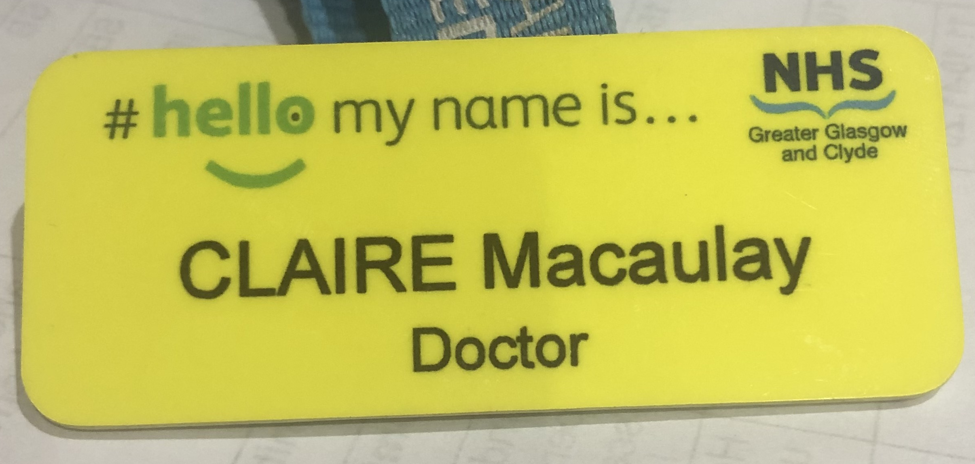

Slide 5

The public mood….results from the British Social Attitudes Survey (King’s Fund/Nuffield Trust)
Satisfaction with the NHS
In 2025, 26% of British adults were ‘very’ or ‘quite’ satisfied with the way in which the NHS runs – a statistically significant 6 percentage point increase from 2024.
Around half of respondents (51%) were dissatisfied with the NHS in 2025, a statistically significant fall of 8 percentage points compared to 2024 when it was 59%.
This is the first increase in satisfaction since 2019, and the largest fall in dissatisfaction in more than 25 years.
Despite the increase in satisfaction only 16% of respondents thought the standard of NHS care would improve in the next 5 years compared to 53% who said they expected care to get worse

Slide 6
Key findings – Satisfaction with NHS in 2025
Satisfaction with GP services was 35% and dissatisfaction was 45%. Neither was a statistically significant change on the previous year.
Just over 1 in 5 respondents (22%) said they were satisfied with NHS dentistry, with 54% saying they were dissatisfied. These are similar results to the previous year.
Only a minority of respondents were satisfied with waiting times for GP appointments (27%), hospital appointments (16%) and in A&E (14%). There were no statistically significant changes compared to last year.
British Social Attitudes Survey 2024 – Kings Fund and Nuffield Trust

Slide 7
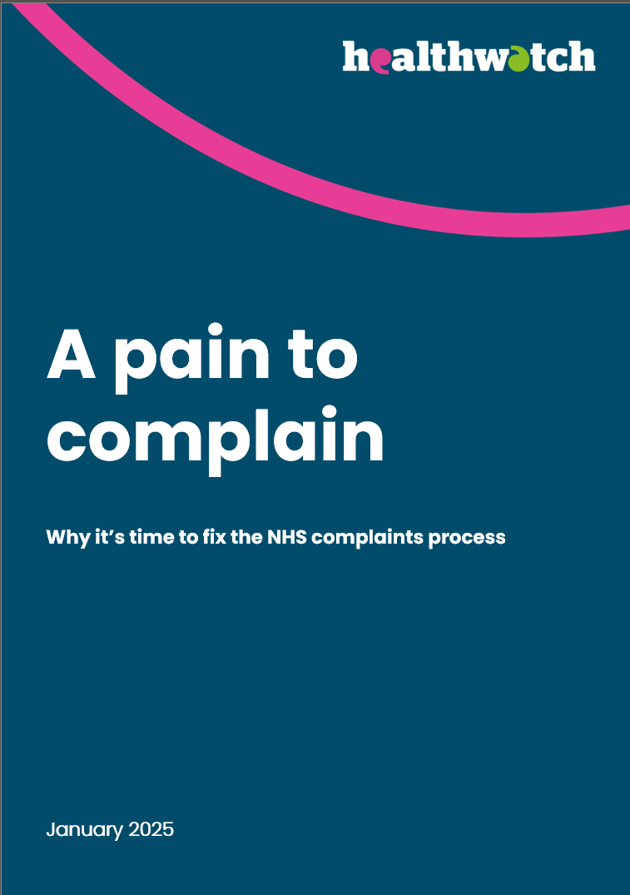

Slide 8
Key findings
Very few patients complain: Almost a quarter (24%) told us they had experienced poor NHS care in the past year. Yet more than half (56%) of people who experienced poor care took no action, and fewer than 1 in 10 (9%) made a formal complaint.
Low confidence stops people acting: Of those who didn’t make a complaint after poor care, 34% believed that the NHS wouldn’t use their complaint to improve services, 33% thought organisations wouldn’t respond effectively, and 30% felt the NHS wouldn’t see their concern as ‘serious enough’.
A poor complaint experience is common: Over half (56%) of people who made a formal complaint were dissatisfied with both the process and the outcome of their complaint.

Slide 9
Participants identified particular problems in trying to raise concerns in primary care:
“Practice managers are behind a wall of receptionists, it’s actually really hard to then go and talk to that practice manager about that receptionist who’s been really rude to you. And that just crops up again and again. People find that really tricky.” – Roundtable participant
“I’ve just analysed around 500 experiences of GP services and the recurring theme is very much that they can’t get hold of the practice manager. They’ll write to them or try and get an email address for them, but they seem to be this elusive figure. And they don’t respond either. It needs to be a lot easier to make primary care complaints” Roundtable participant

Slide 10
Primary care
Issues with primary care complaints stood out as a key concern in our roundtable discussions. Unlike in trusts – which have PALS or complaints teams working separately from front-line staff - in settings like GP surgeries complaints go directly through a practice manager, in close and regular contact with clinicians.
We heard that people may feel less confident that the investigation will be fair and balanced, putting people off making any complaints.
“Patient submitted a complaint…regarding what he feels is discriminatory behaviour by a member of healthcare staff. He has since found out that the individual who the complaint against is investigating it. He does not see how this is fair or will result in an impartial outcome. He no longer wants the individual to be involved in his healthcare, but she seems to be the only one that supports patients with long term conditions.” - Story shared by Healthwatch East Sussex

Slide 11

10 Year Plan and Complaints
“We will update the complaints regulations”
“The NHS complaints procedure is far from where it needs to be”
“Complaints often receive a formulaic response”
“We will significantly improve the complaints process within all NHS commissioners and providers”
“We will set clear standards for timeliness and quality of responses to complaints”
“We expect to… put a megaphone to the mouths of complainants”
Notes:
Plain slide with subhead and bullets

Slide 12
Use of Artificial Intelligence – friend and foe?
We know patients are using AI to make complaints. For some patients it is making the complaints process accessible in ways it might not have been before. We also know that AI can produce unhelpful correspondence which can make it difficult to understand the complaint. The PHSO has said:
We want to hear about your complaint in your own words. We know some people find AI tools such as ChatGPT helpful when completing the form. Please be aware that AI-generated text can make complaints too complicated or include legal references that are not relevant. This may increase the time it takes us to review your complaint or we may need to ask you to resubmit it.
Filling in our complaint form | Parliamentary and Health Service Ombudsman (PHSO)

Slide 13

Why must we manage complaints? GMC says so…”Being Open”
“45. apologise (apologising does not, of itself, mean that you are admitting legal liability for what’s happened)”
“46. You must respond promptly, fully and honestly to complaints. You must not allow a patient’s complaint to adversely affect the care or treatment you provide or arrange.”

Slide 14
What is a complaint?
“ a complaint or concern is an expression of dissatisfaction about an act, omission or decision of the provider, either verbal or written, and whether justified or not, which requires a response.”
Source: NHS England Complaints Policy, 2017

Slide 15
What will we cover?
The Regulations
Practical tips
The art of apology
The role of NHSE/ICB
What if things escalate? To where?
Demonstrating CQC compliance

Slide 16
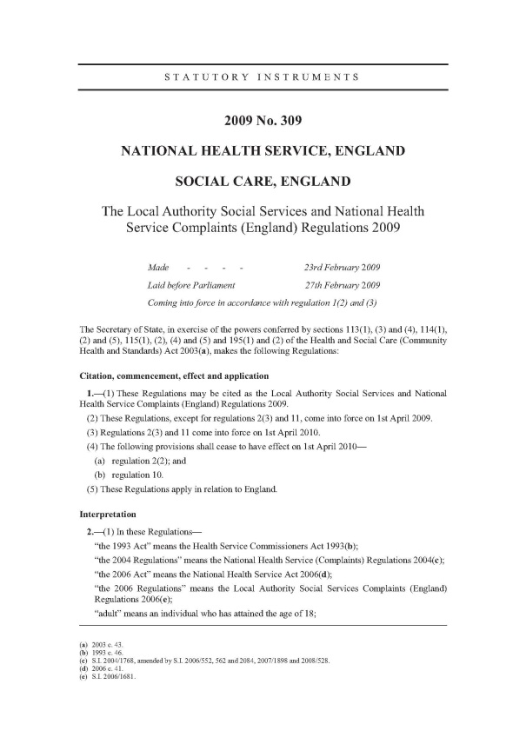
Why is it important to ‘get it right’?
Because the Local Authority Social Services and National Health Service Complaints (England) Regulations 2009 require you to.
Notes:
This is the legal basis of the NHS Complaints Process – we will focus more on what the regulations are shortly

Slide 17
The Regulations Part one:
If an issue raised orally can be resolved to the complainant’s satisfaction not later than the next working day (24 hours), it is not required to be dealt with as a complaint
Oral complaints (not resolved within 24 hours) must be written up and shared with complainant to agree the content
You cannot tell a complainant they “MUST put it in writing”
When in doubt “is this a complaint or a concern/feedback?” ask the patient/enquirer
No issue is too small to be a complaint or too big to be a concern

Slide 18
The Regulations (continued)
A complaint must be acknowledged no later than the 3rd working day after it is received.
The acknowledgement must include an offer to discuss the handling of the complaint and a timeframe in line with the regulations.
A complaint should be made within 12 months of the event or of the complainant knowing they had cause to complain.
If you can respond, you should, even if it is out of time.
The regulations do not stipulate a timescale for responding to a complaint. This should be agreed with the complainant as part of the acknowledgement process.
If you do not provide a response within 6 months, the complainant can approach the PHSO.
Duty to co-ordinate and/or co-operate with multi agency complaints – not in isolation

Slide 19
Organisation at the practice
A complaint can be made to either the provider or commissioner of a service, but not to both.
You must have a full working complaints policy for the practice which reflects the regulations and your local organisation.
You must have a well publicised complaints process, ideally a leaflet and a poster which is the simple version of your policy.
Each practice must have a “responsible person” for complaints and a complaints manager.
“As soon as reasonably practicable after completing the investigation, the responsible body must send the complainant in writing a response, signed by the responsible person”
Responsible person defined as sole proprietor, or in the case of partnership a partner, or in any other case a director of the responsible body…

Slide 20
Organisation at the practice
Consider a Deputy. You cannot delay dealing with a complaint or updating a complainant because the Complaints Manager is ‘away’.
Practice should make an annual report on complaints available to the commissioning body upon request.
KO41b data return on complaints is published by NHS Digital (now part of NHSE) annually.
When staff leave, retain contact details – they don’t leave their complaints behind – they have a duty to comply, but the practice is responsible for investigating and responding.

Slide 21
What will we cover?
The Regulations
Practical tips
The art of apology
The role of NHSE/ICB
What if things escalate? To where?
Demonstrating CQC compliance

Slide 22
Acknowledgement
This is your first contact – make this letter count!
Thank them for the complaint but apologise for their experience (sad but glad)
Address and deal with any consent issues
Offer to discuss the handling of and clarify the complaint
Explain the timeframe for responding and what happens if it takes longer – offer to negotiate
Explain who investigates and how
Provide a named contact for the complainant

Slide 23
Remember they are human
Let them know you are listening - EARS
Explain
Explain how the outcome will be shared with them and ask if they wish to receive the response in a format other than in writing
Address
Address any immediate care/appointment issues
Reassure
Make clear that their care and that of their family will not be compromised as a result of making a complaint
Support
Include details of a local NHS complaints advocacy provider

Slide 24
Investigation - first steps
Who is complaining - Do you have consent?
Take a highlighter pen and identify every issue requiring a comment/response.
Identify who needs to answer each of the above.
Is there a need for independence?
Get the records and any additional information you may need.
Suspend your assumptions – “my staff would never…..”
Identify if any other organisations are involved.
Don’t be afraid to ask the complainant if you need more information.
What happened Vs What should have happened
24

Slide 25
Investigate fully – What actually happened?
Consider the use of statements – advise staff to seek advice early.
Do the statements correlate with the notes?
Do you need more information from other agencies?
Prepare a detailed, factual, chronological account of what happened.
25

Slide 26
Investigate fully – What should have happened?
What is the complainant right about?
Offer an apology if appropriate
Is there a remedy needed?
Highlight what the learning points are and what action will follow.
26

Slide 27
Formulate your response
Section 1
Open with a “sad but glad” statement and an assurance that the practice takes all complaints seriously.
“ I was very sorry to learn that you are unhappy with the care that you have received from the practice and I am grateful that you have brought this to my attention. The practice takes all complaints very seriously and I have investigated your complaint in line with our complaints process.”
27

Slide 28
Formulate your response
Section 2
Explain the investigation.
“ I have conducted a full investigation of your complaint. I have spoken with (insert names of those involved) and they have provided me with an account of their recollections of what happened. I have reviewed your medical records and sought additional information from (insert any other information obtained).”
28

Slide 29
Formulate your response
Section 3
Give a factual account of what happened.
Give the full details of all aspects of the care provided in relation to this complaint.
Include any additional information if it is relevant.
Make sure you have covered all the points raised in the complaint letter
Give names of staff involved.
29

Slide 30
Formulate your response
Section 4
Give an account of what should have happened.
Apologise meaningfully.
Set out what you are going to do now to prevent a recurrence.
Where the complaint is warranted – say so clearly.
Set out what you are going to do to make things right for this person.
30

Slide 31
Formulate your response
Section 5
Close off with a summary and a repeat apology if warranted.
Explain what the complainant should do if they remain unhappy.
Offer thanks that the complainant brought the matter to your attention.
Offer to feedback after any action is taken.
Provide details of the Ombudsman.
31

Slide 32
What will we cover?
The Regulations
Practical tips
The art of apology
The role of NHSE/ICB
What if things escalate? To where?
Demonstrating CQC compliance

Slide 33

Journalist Frank Gardner
Complaining about Heathrow airport losing his wheelchair and being abandoned on plane for nearly 2hrs…

Slide 34
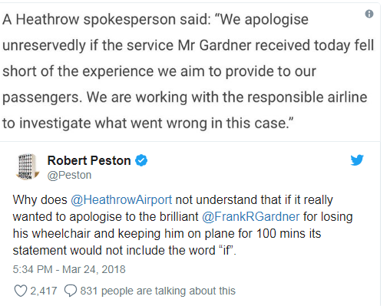

Slide 35
No “ifs or buts”
The complainant has told you that they are unhappy/upset/cross/worried. You don’t get to decide that they are not.
  “I’m sorry if you were upset….”
Don’t ruin an apology with an excuse
  “I am sorry that you were upset but…..”
“But” negates everything that came before
  “ I’m saying sorry, but really I think I was right.”
35

Slide 36
The legal position of apologies
The Compensation Act 2006:
“An apology, an offer of treatment or other redress, shall not of itself amount to an admission of negligence or breach of statutory duty”

Slide 37
PHSO, “Broken Trust”
June 2023
“Guidance from NHS Resolution makes it clear that apologising is not an admission of fault or liability. The same guidance highlights that organisations must make meaningful apologies when things go wrong. It states that a meaningful apology ‘is vital for everyone involved in an incident, including the patient, their family, carers, and the staff that care for them.
But we still see organisations that fail to give a genuine apology. Organisations may say sorry and accept that failings happened, but it is rarer that they offer a clear and unreserved apology that shows they have understood the impact of those failings on the patient. Advocates also told us they often see organisations send apology letters that say ‘I’m sorry if you felt that…’ rather than offering a sincere apology.”
Notes:
https://www.dentalprotection.org/uk/about/media-centre/press-releases-display/2018/06/01/effective-in-house-systems-can-nip-complaints-in-the-bud 2056 UK adults

Slide 38
PHSO, “Broken Trust”
June 2023
‘I don’t think that they did it with a good grace. I think it was just a formula … They weren’t sorry that they’d done it, they were sorry they’d been caught.’
This is a quote from a complainant referenced by the PHSO in “Broken Trust”. The healthcare provider only apologized because the PHSO told them to as part of their findings
Notes:
https://www.dentalprotection.org/uk/about/media-centre/press-releases-display/2018/06/01/effective-in-house-systems-can-nip-complaints-in-the-bud 2056 UK adults

Slide 39
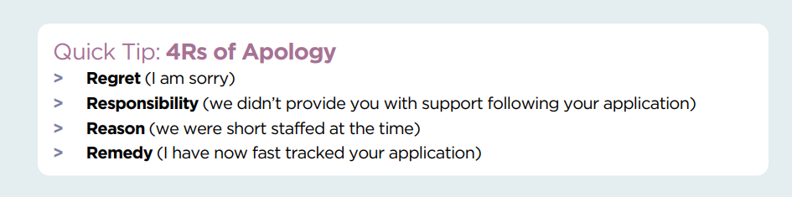
Scottish Public Services Ombudsman – apology guidance

Slide 40


Slide 41
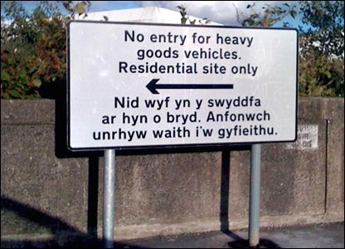
Communication – good intentions
41

Slide 42
Communication – good intentions
“I am out of the office – please send translation work by post”

Slide 43
What will we cover?
The Regulations
Practical tips
The art of apology
The role of NHSE/ICB
What if things escalate? To where?
Demonstrating CQC compliance

Slide 44
The Role of NHS England – all change!
On 1 April 2023 NHS England delegated its complaints function to ICBs (following the delegation of commissioning)
NHS England only handles complaints pertaining to specialised commissioned services and any about national function or policy
NHS England being abolished in 2027 – more services to be delegated/transferred to ICBs
The Bill working through parliament will address what a complaints function in DHSC might look like
Over to Cathie to describe ICB complaints handling…

Slide 45
The Role of ICB’s in Primary Care complaints handling
Since July 2023 ICB’s have been responsible for handling complaints about Primary Care services, in instances where a complainant requests a response from the commissioner of the service.
Complainants make their complaint to individual ICB’s and where possible and agreeable to the complainant, ICB’s will try to facilitate local resolution.
Formal complaints are passed to a dedicated Primary Care complaints team to manage; this team services all East Midlands ICB’s.
Whilst contact with the complainant during the investigation is with the East Midlands Primary Care complaints team, the complainant will receive their response from the individual ICB.

Slide 46
The ICB Primary Care Complaints Investigation
Complaint received and logged by the Primary Care complaints team
Acknowledgement letter sent and complaint points agreed with the complainant
Appropriate consent requested
Consent received
Complaint sent to provider requesting a response and copies of associated records
Response received from provider and reviewed to ensure it addresses all of the complaint
Revised response requested if gaps are identified
Clinical or contractual review requested where appropriate and shared with provider
If learning identified, opportunity for provider to reflect and respond
Final response drafted and sent to ICB for CEO sign off
Final response sent to complainant with copy to provider
Referrals to Professional Standards made where indicated (very rare)

Slide 47
What will we cover?
The Regulations
Practical tips
The art of apology
The role of NHSE/ICB
What if things escalate? To where?
Demonstrating CQC compliance

Slide 48
Where can a complaint escalate to?
The Ombudsman (PHSO)
The GMC
Claim for negligence

Slide 49

What does good look like?
Principles of Good Complaint Handling:
  Getting it right
  Being customer focused
  Being open and accountable
  Acting fairly and proportionately
  Putting things right
  Seeking continuous improvement

Slide 50
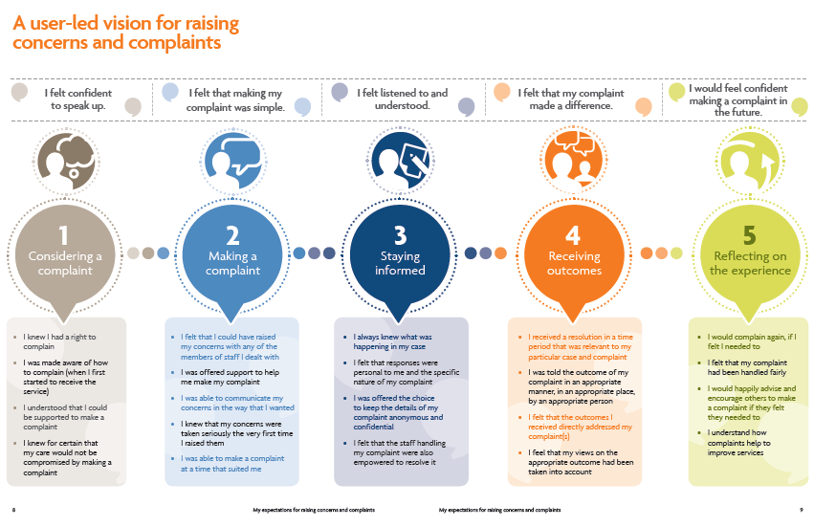
What does good look like?

Slide 51
What does the PHSO consider?
Is this in time? (12 months)
Is local resolution complete?
Is it reasonable for the complainant to take legal action?
Has there been maladministration or service failure resulting in injustice or hardship?
How has the organisation dealt with the complaint?

Slide 52
PHSO process
Investigation
  Delays at PHSO triage at present
  Can interview staff
  Will review your complaint file and medical notes
  May seek independent clinical advice
  New process from April 2021 – threshold has changed to look at more “serious” issues

Slide 53
PHSO process
Outcome
  Provisional views - 2 weeks to comment
  upheld, partly upheld, not upheld
  makes recommendations
  requests action plan (and follows up)
  No power to enforce recommendations - but expects them to be implemented.

Slide 54
PHSO financial remedy guidance
Six-point scale up to £12,500
Poor complaint handling alone can incur a financial remedy
Level 2 £120-£550
  “poor complaint handling where there is a delay of more than a few weeks, up to around one year.
Level 3 £600-£1200
  “Very poor complaint handling; e.g. delays of over a year; or with delays of over six months combined with qualitative failures such as provision of incorrect or incomplete responses”
Notes:
PHSO rec’d and completed in 2017/18

Slide 55
PHSO Complaints Standards 2023
Complaints Standards:
PHSO long term aim to become Complaints Standards Authority
Standards were piloted in 2022/23
PHSO have been using them in their casework from 1 April 2023
Notes:
PHSO rec’d and completed in 2017/18

Slide 56

PHSO Complaints Standards 2023
Notes:
PHSO rec’d and completed in 2017/18

Slide 57
PHSO Complaints Standards 2023
NHS Complaint Standards | Parliamentary and Health Service Ombudsman (PHSO)
Notes:
PHSO rec’d and completed in 2017/18

Slide 58
Managing Challenging Situations
NHS Complaint Standards: managing challenging situations in complaint handling
“This guide explains what you can do when you are considering a complaint and find yourself in a challenging situation.
This includes situations where:
you find it difficult to engage with the person who has made the complaint
the person uses behaviour that you find challenging, or that is unreasonable or unacceptable.
We define unreasonable or unacceptable behaviour as any behaviour by a person that raises substantial health, safety, resource or fairness issues for the people involved – either because of the type of behaviour or how often it happens.”

Slide 59

The GMC
“We only investigate serious concerns about doctors. So, we are the people to go to if you think a doctor shouldn't work unrestricted in the UK.
What we can't help you with is:
giving you an explanation of what happened to you
ordering a doctor to give you the treatment you want or access to your records
helping you with a claim for compensation
fining a doctor or make a doctor apologise.”

Slide 60
GMC complaints – 393, 357 doctors on register
Complaints
Made by public
Investigation (at triage)
10, 769
8279
Closed at triage
9087
843
Erased
67
GMC Fitness to Practise Statistics 2024
Notes:
PHSO rec’d and completed in 2017/18

Slide 61
Complaint to practice and GMC?
People may complain concurrently.
If the GMC do not investigate, you may know nothing about it.
  the GMC may ask you to review at your appraisal.
A good NHS complaint response can be very helpful to submit to the GMC.
If you get a letter from the GMC, don’t panic and seek MDO advice

Slide 62

Claims for negligence
A claim and a complaint can run concurrently.
Claims can be brought up to 3 years after the event.
People bringing a claim are often seeking an explanation, apology or reassurance of lessons learned, rather than compensation.
A good complaint response and maintenance of a good relationship may avoid a claim.
State indemnity for primary care – dissemination of learning by NHS Resolution

Slide 63
What will we cover?
The Regulations
Practical tips
The art of apology
The role of NHSE/ICB
What if things escalate? To where?
Demonstrating CQC compliance

Slide 64

Why complaints matter to the CQC
“Complaints handling is an excellent proxy for an open, transparent and learning culture that we would expect to see in well-led organisations.”

Slide 65
Regulation 16: Receiving and acting on complaints
“To meet this regulation providers must have an effective and accessible system for identifying, receiving, handling and responding to complaints.
All complaints must be investigated thoroughly and any necessary action taken where failures have been identified.
When requested to do so, providers must provide CQC with a summary of complaints, responses and other related correspondence.”
Health and Social Care Act 2008 (Regulated Activities) Regulations 2014: Regulation 16

Slide 66

Examples of “Inadequate” rating
Practice 1
Complaint received in April and not acknowledged or responded to until September.
Two complaints had been logged as concerns and not dealt or included in the complaints log.
No process in place to review complaints annually to identify themes or trends. No evidence of how learning from complaints had been disseminated to staff.
Practice 2
Complaint information held in different places and no audit trail to ensure which complaints still required action.
No system in place to analyse and learn from complaints.
No formal meetings attended by clinical and non-clinical staff to discuss complaints, ensure they were handled appropriately, analysed and learnt from.

Slide 67
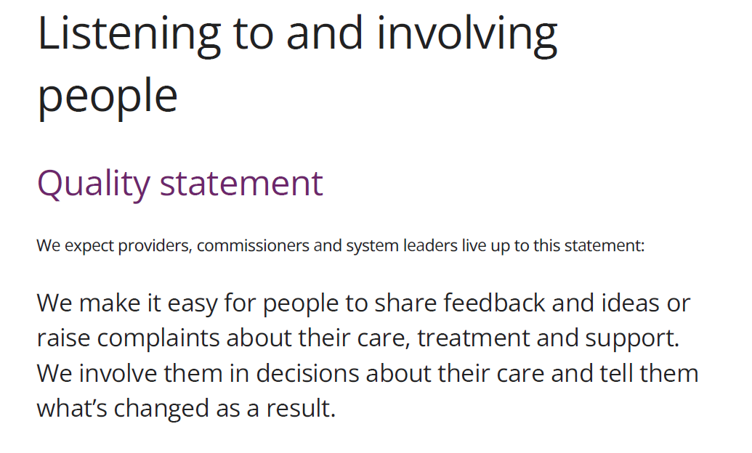
Quality Statements

Slide 68
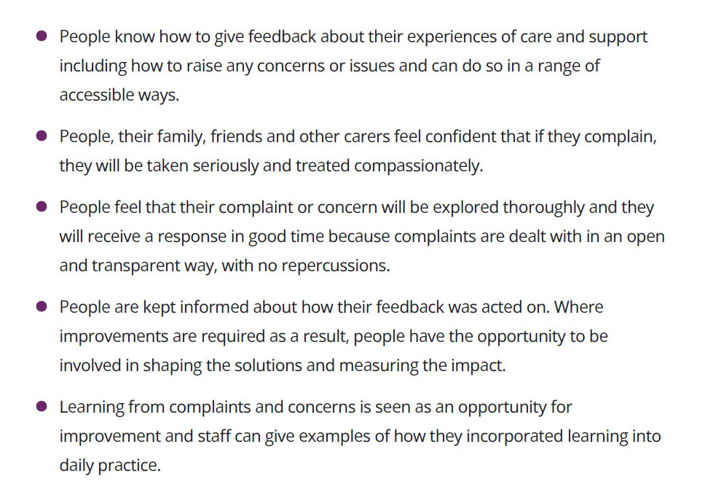
Quality Statements

Slide 69
What will CQC look for?
Review of your complaints log
Evidence of staff training on dealing with complaints
Ask staff about the complaints process
Ask to see complaints leaflet
Are your complaints dealt with in line with your policy?
Evidence of how learning has been shared

Slide 70
Tips to evidence learning
Document staff training on complaints – make sure everyone knows the policy and where to find the leaflet.
Have complaints as a standard agenda item at practice meetings.
Share action points with patients on website/newsletter/waiting room.
Document the action plan and when actions have been completed.
Make sure you document correspondence with locums/other agencies.

Slide 71
PHSO, “Broken Trust”
June 2023
“Most complainants want assurances that something is being done to prevent the same mistakes from happening again. In our recent research on motivations for complaining, 93% of respondents said ‘ensuring that others don’t face the same issues in the future’ was either very important or important in their decision to complain. Similarly, in our interviews with complainants, they all said part of the reason why they complained was to make sure the same thing does not happen to other patients, families and carers.
Being able to show that learning has happened is vital if families are to feel their complaint has achieved its purpose. Responses that do not feel meaningful can leave families feeling badly let down and frustrated.”

Slide 72

What do the numbers tell us?
Notes:
https://www.dentalprotection.org/uk/about/media-centre/press-releases-display/2018/06/01/effective-in-house-systems-can-nip-complaints-in-the-bud 2056 UK adults

Slide 73
Complaints in the NHS – the numbers!
123,447 GP complaints in 24/25 (113,041 in 23/24)
Primary Care total; 142,977
(dental/ICB make up the rest)
Highest recorded numbers (but some under reporting still occurring)
But what were they about….
Data on Written Complaints in the NHS 2024/25 Digital NHSE

Slide 74
Complaints in the NHS – Causes (GP)
Clinical Treatment - 17%
Communication – 13%
Staff Attitude & Behaviour – 12%
2 of the top 3 by subject relate to the customer experience/how people feel/how you speak to them
Data on Written Complaints in the NHS 2024/25 Digital NHSE

Slide 75
Customer service is critical
It takes 12 positive customer experiences to make up for 1 negative one.
Ruby Newell-Legner, “Understanding Customers”
70% of customer experiences are based on how the customer feels they are being treated.
McKinsey & Company
An organisation which uses feedback to improve is much more likely to be successful than one which does not.
SPSO
62% of customers say they share their bad experiences with others.
Salesforce Research

Slide 76
Mythbusters
Complaints have to be put in writing
NO

Slide 77
Mythbusters
A patient who has complained should be asked not to return to the practice
NO

Slide 78
Mythbusters
You have to respond to a complaint within 10 working days
NO

Slide 79
Mythbusters
After complaining to the practice a patient can complain to the ICB
NO

Slide 80
Summary
Complaints are common – expect to deal with them.
Review your complaint process – and use it!
Think about “customer service.”
Consider complaints as an opportunity.
You are responsible for your reputation.
PHSO Complaints Standards are here.
Notes:
https://www.dentalprotection.org/uk/about/media-centre/press-releases-display/2018/06/01/effective-in-house-systems-can-nip-complaints-in-the-bud 2056 UK adults

Slide 81
Dan Wellings, Kings Fund “Patient Experience, Who Is Listening”
October 2023
“The story behind Martha’s rule is depressingly familiar. A parent raising significant concerns about their daughter’s ongoing care only to be ignored with tragic consequences. Unfortunately, this feels like the latest in a long line of incidents where the NHS has failed to heed warnings from patients and their families about the quality of their care.
At the heart of all this there are disturbing themes around culture, hierarchy, power imbalances and institutional defensiveness. Simply put it is about patient voice not being sufficiently valued.”
Notes:
https://www.dentalprotection.org/uk/about/media-centre/press-releases-display/2018/06/01/effective-in-house-systems-can-nip-complaints-in-the-bud 2056 UK adults

Slide 82
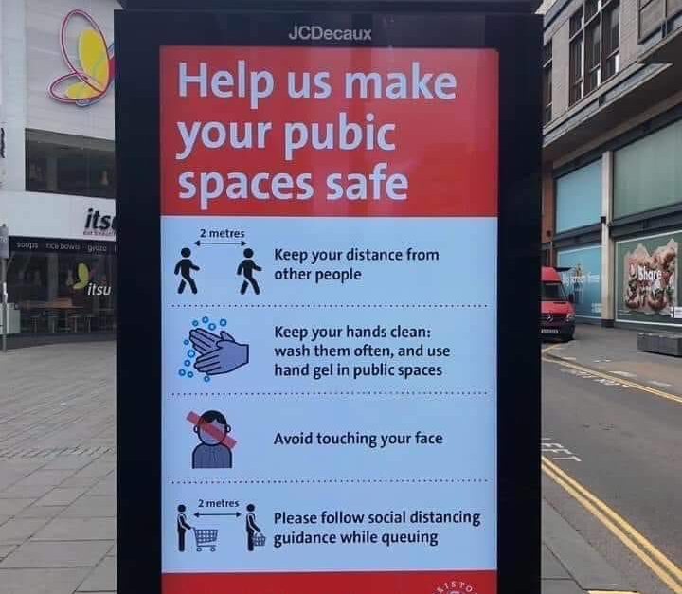
Typos and Tone!
Notes:
https://www.dentalprotection.org/uk/about/media-centre/press-releases-display/2018/06/01/effective-in-house-systems-can-nip-complaints-in-the-bud 2056 UK adults

Slide 83
Questions?
Notes:
https://www.dentalprotection.org/uk/about/media-centre/press-releases-display/2018/06/01/effective-in-house-systems-can-nip-complaints-in-the-bud 2056 UK adults

