Slide 1



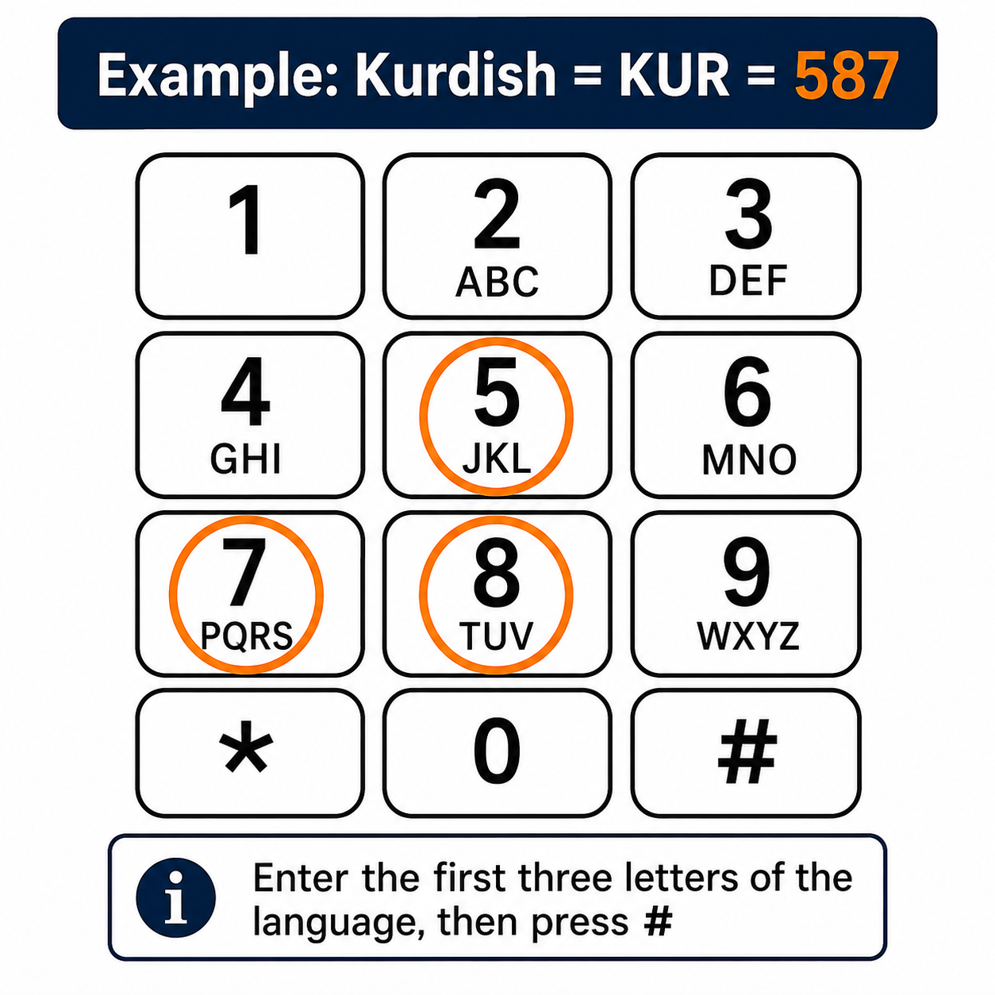

Interpreter Services User Guide
Quick Reference • Standard Operating Procedure
Interpreting Translations Ltd
Strictly Confidential: For Authorised Users Only. Keep this page secure
How To Access On-demand Telephone Interpreters For Emergencies Only
1
CALL
Call 0121 285 3609
Say or enter your PIN Code: 6803902
Please enter your Practice ID: this was emailed to the
Practice by Leicestershire Partnership NHS Trust
Enter the first three letters of the language,
followed by
  *1# for any gender
  *2# for female
  *3# for male
Wait for the list of available languages for selection
If your patient is with you, Press *# to skip, OR
enter your patient’s number followed by #
For example, if you need a Kurdish interpreter, you will press 587 on your phone pad. This is because as you can see on the Phone Keypad image, letter K is included with Keypad 5 and letter U is included with Keypad 8 and letter R is included with Keypad 7 all of which will make KUR (short for Kurdish).
⚠
Important note
2
PIN
Where possible, please pre-book requests via the portal for these languages:
3
ID
1. Tetum
2. Fataluku
3. Indonesian
4. Kurdish Badini
5. BSL (Sign Language)
6. Konkani
7. Soninke
8. Tigrinya
9. Amharic
7. Czech
8. Slovak
7. Mandinka
8. Telugu
9. Tagalog
10. Turkmeni
11. Zaghawa
4
ABC
5
LIST
6
OK
How the language keypad code works?
Use the first three letters of the language and match each letter to your telephone keypad.
Example: Kurdish = KUR = K on 5, U on 8, R on 7. Enter 587 followed by #.
If more than one language or dialect matches the same three numbers, the system will read out the available options. Select the correct language from the list.
Technical Support: If you experience technical difficulties or cannot find your required language, please call us on 0121 270 6801, selecting option 2 for support.
For supports required outside office hours or on weekends, please call 0742 750 3009

