Slide 1
NHS Health Checks 2025
Tuesday 16th September. 14:00
With
Daniel Hallam, Gavin Yarnold
and our Support Team
Notes:
Leanne - introduction
Clarify the meeting is for ADHD Adult Service - provider ‘bidders’ information event
Ask providers to put their name and organisation in the chat box
Remind them meeting is being recorded
Thank you to everyone who has come to the session and hope people will find it informative.

Slide 2
Agenda
Introduction and aims for the session (Daniel)
Part One - The specification
The current context
Our specification and
What does this mean for your GP Surgery
Question and answer session
Part Two - Procurement of new NHS Health Checks contracts (Gavin)
What is the process?
Where and when you can ask clarification questions
What support is available?
Timescale
Question and Next Steps
Summary and next steps
Notes:
Leanne – introduce the agenda for the day.
Basic housekeeping – stay on mute.
There will be opportunities for Q and A session at the end of each section.
We are taking a detailed record of the event – any questions that we are unable to answer in the session , we will respond to after the session.
XXXXX will be monitoring the chat and will respond to messages

Slide 3
Aim of the session
By the end of today's session, the aim is that you will have a clear understanding of :
The local context in Leicester City for NHS Health Check services, the introduction of the new contract, and the support network we are offering to help you complete the exercise.
How to register on to the Procurement portal called “ProActis” and how to respond to our invitation when it goes live.
The next steps for the procurement exercise under contract Direct Award route B. You are NOT be required to participate in any competitive exercise, this is a formality under new legislation.
We also want to make sure that you can ask any
questions that you may have.
Notes:
Leanne

Slide 4
Current context
LCC Public Health currently commissions with all GP practices in Leicester to deliver NHS Health Check programme.
Mandated service to be delivered in conjunction with the public health grant.
Current contracts need to be renewed and brought in line with new PSR guidance and legislative processes.

Slide 5
Current context
GP practices are paid £20 for completion of part 1 of the check (main check).
A further £28 payment is made for a part 2- those put onto a clinical management plan and identified as ‘high risk’ (>10% CVD QRISK score).
Pricing structure is in accordance with available budget and what other local authority areas pay.
Constantly reviewing ongoing need to ensure suitability of offer, and how this meets demand/access for both eligible and targeted population.

Slide 6
Current context
The main elements of the current specification/contract are:
Universal offer for providing NHS Health Checks to eligible population.
For those aged 40 to 74 not already diagnosed with a pre-existing medical condition or already on a clinical risk register.
Individuals should be invited at least once every five years.
The new elements are:
Updated specification to reflect PCN model whereby patients can visit a GP practice other than their own for an NHS Health Check.
Ensuring a proportionate universalism approach to providing NHS Health Checks for eligible population.
Look to increase high risk patient (QRISK >10%) attendance, in turn increasing additional income for practices.
Continued improvement around NHS Health Check templates and payment process.
Integration of proposed digital NHS Health Check as part of current service.
Notes:
Leanne- explain it is a co-produced spec with people with Lived Experience
Summarise requirements

Slide 7
What this means for your GP practice
Continue to deliver NHS Health Check service as before.
Contract length will be for a total of 7 years.
Continued source of income and support for your practice through ongoing delivery of NHS Health Check programme.
We want to ensure re-procurement process is made as simple and straightforward as possible for practices.
Look to work with Leicester City Council colleagues to ensure process is followed in accordance with legislative guidance.
Continue to be paid and supported as a result.
Notes:
Summarise requirements

Slide 8

Q and A session
Notes:
Leanne to lead
Any remaining questions to be typed into the chat box and we will respond after the event.

Slide 9
Part Two
Procurement of the
NHS Health Checks Contract
What is the process?
Where and when you can ask clarification questions.
What support is available?
Timescales
Presented by Gavin Yarnold,
Procurement Service Manager
Notes:
Gavin

Slide 10
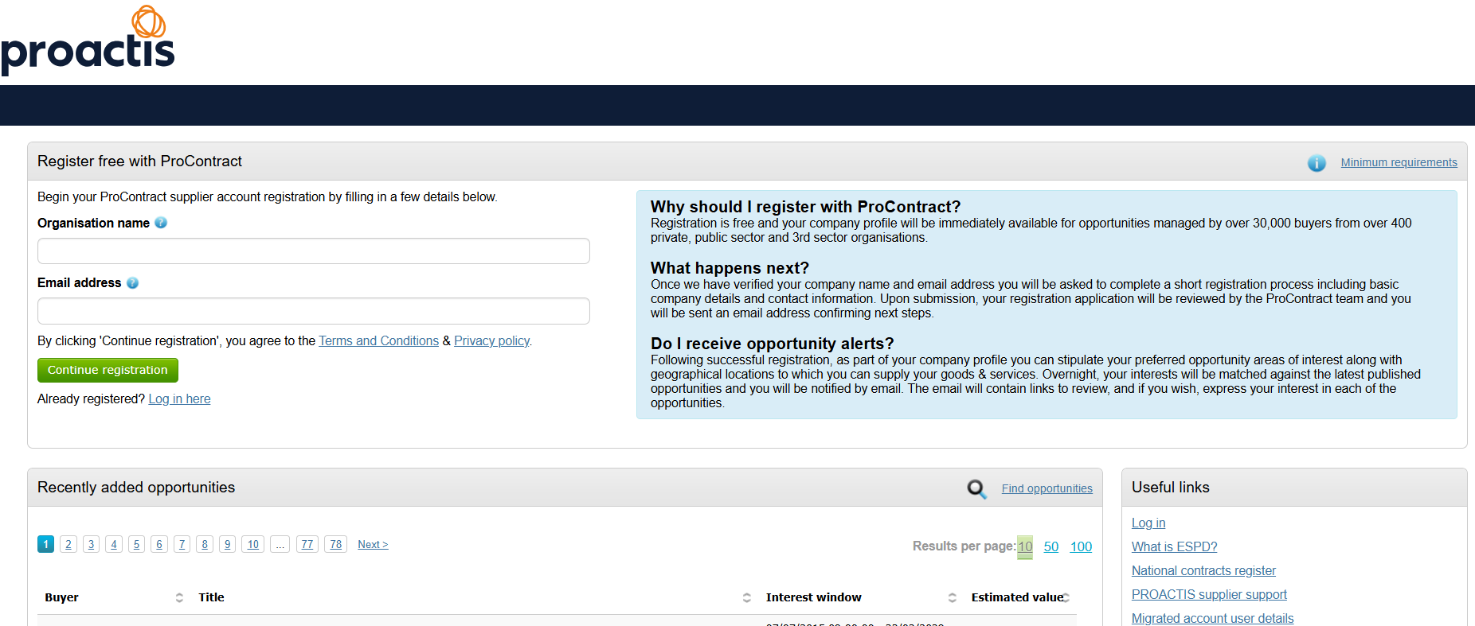
What will this mean for you? ProActis Registration
This project requires each organisation wishing to take part to register on the Due North electronic procurement portal.
www.eastmidstenders.org
Notes:
Gavin

Slide 11
Support available
ProActis: Due-North Support
From next week, there will be several time slots made available for technical support for everyone. This will be from Liane, Robbie, and myself. Charlotte will distribute a list of dates and times we will be available to help you. All you’ll need to do is tell Charlotte any slot you’d like to meet with us, and we’ll send you an invitation.
Alternatively, there is further support at: email ProContractSuppliers@proactis.com for ProContract Supplier Support
Notes:
Gavin

Slide 12
Direct Award Route B – Contract Award
Direct Award Route B refers to a process for healthcare services under the Provider Selection Regime (PSR), where patients have a choice of providers, there are no restrictions on the number of available providers, and contracts are offered to all who meet the requirements.
This route is specifically for health services where the patient can select from multiple qualified providers, ensuring all capable suppliers can access the contract without arbitrary limits.
Notes:
Gavin

Slide 13
The Administrative Phase
Following this session, an email will be sent to everyone in this Meeting, and this shall contain instructions to register on the portal.
The documents you are required to complete will be sent to everybody via the ProActis portal. This is called an Expression of Interest Response Document
You shall have approximately 5-6 weeks to register and complete the Response Document
There will be Technical Support Sessions available throughout this time
Response Documents to be submitted by 9th January 2026
Contract Issued on receipt of the Response Documents

Slide 14
Required Documentation
Health & Safety:
Health & Safety Policy
Health & Safety Manual
Data Protection:
Evidence of a clear hierarchy responsible for Information/Data Protection within the organisation
Data Protection Policy reflecting Data Protection Act 2018
Records Management Policy and retention schedules
Information and ICT Security Policies and process for managing information security incidents
Staff training records and evidence of a process to refresh training regularly
Guidelines for handling information (clear desk approach, secure offices, storage etc)
Any compliance with ISO27001, Cyber Essential or equivalent certifications.

Slide 15
Contract Award Phase
We aim to have all contracts to GPs issued by 2nd February
You will have another 6 weeks to sign and upload your contract for countersignature
You can submit either via Docusign, or via the portal. Instructions will be given.
There will be Technical Support Sessions available throughout this time

Slide 16
Awarding Your Contract
A Contract Award Notice will be published week commencing 2nd February 2026.
Countersigned Contracts will be re-issued in one day, meaning you shall all receive your new contracts on the same day.
There is no commercial advantage with any contract – they will be identical except your Surgery details.
NHS Health Checks Contract commence:
1st April 2026

Slide 17
Discussion Q and A session
Notes:
Leanne to lead, any remaining questions please put in the chat box and we will answer after the session.

Slide 18
Summary – next steps
Register on ProActis Portal over the next two to three weeks
Watch out for the Participation email you will be sent via the ProActis portal – an email will also be sent by Procurement to tell you log into the portal
These slides will be shared after the session.
All questions will be responded to and shared after the event with all providers.
Any queries contact the procurement email:
procurement-asc@leicester.gov.uk
Notes:
?

Slide 19


