Slide 1
COVID-19 data update
20/08/2021
Contact: Alanna Wurm, Policy Advice and Research Officer, Public Health and Healthcare
awurm@bma.org.uk

Slide 2
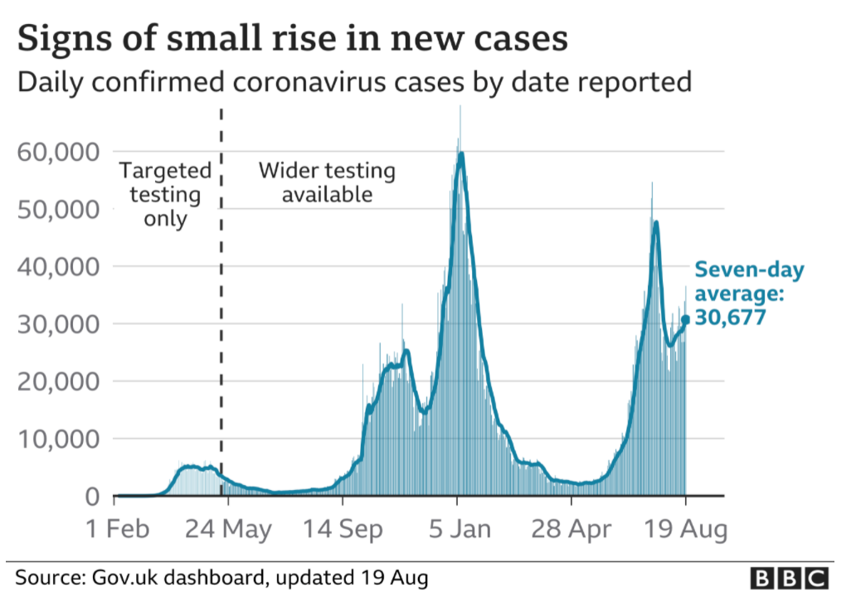
Cases – UK wide
Highlight:
There were 36,572 confirmed COVID-19 cases across the UK reported on 19 August. This compares to 33,074 new cases reported in the last update (12 August). ​
​
The number of new cases has risen slightly, with a seven-day average of 30,677.
Source: Gov.uk COVID-19 dashboard (graph via BBC)

Slide 3
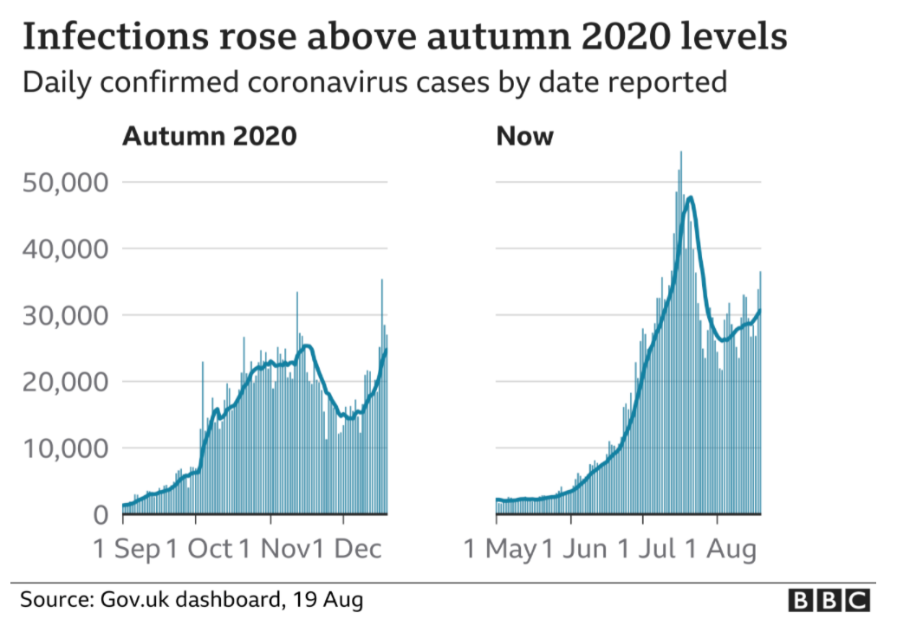
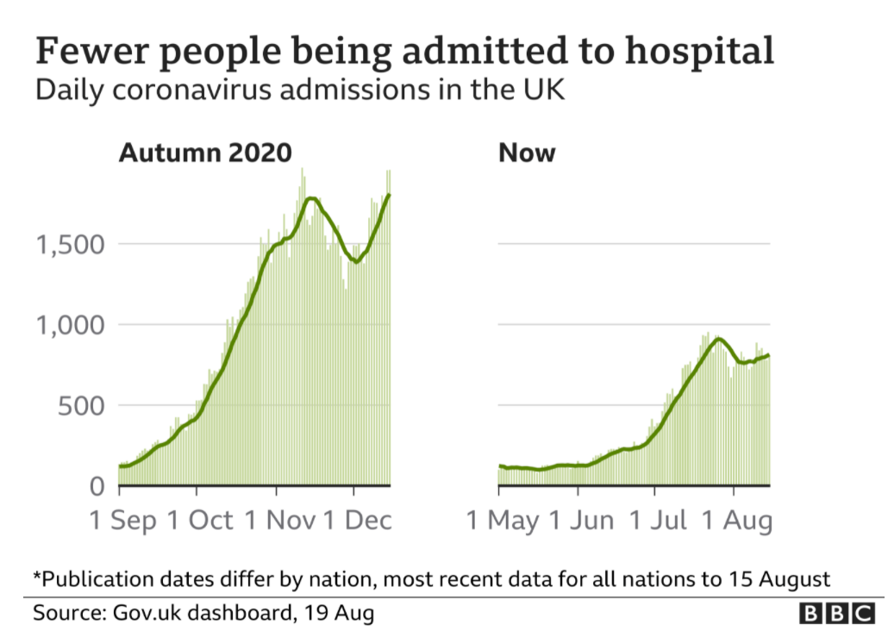
Infections and hospitalisation – UK wide
Source: Gov.uk COVID-19 dashboard (graph via BBC)

Slide 4
Cases by nation (and English regions)
Highlight:
Latest figures demonstrate a slight increase in the number of COVID-19 cases across some areas of the UK. There continues to be considerable variation in cases between different areas in England.
Cases per 100,000 by English region, last 7 days
Cases per 100,000 by nation
English Region | Cases per 100k | % Change compared to last week
Yorkshire and The Humber | 368.3 | -2%
South West | 348.2 | +4%
East Midlands | 347.9 | +2%
West Midlands | 308.2 | +9%
North West | 303.6 | +3%
South East | 284.3 | +10%
London | 278.6 | -1%
North East | 277.7 | -4%
East of England | 267.2 | +2%
Source: Gov.uk COVID-19 dashboard (BMA graph)

Slide 5
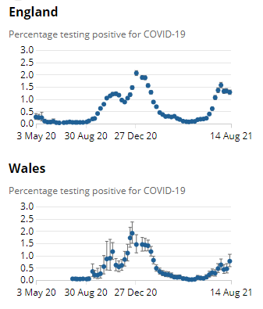
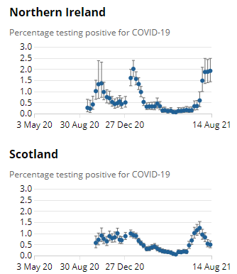
ONS infection survey data
Highlight:
Latest ONS infection survey data runs up to 14 August and shows an increase in cases in Northern Ireland and Wales, and a decrease in England and Scotland.
Nation | Estimated pop with COVID-19 | Previous week
England | 698,100 | 726,700
Wales | 23,500 | 14,100
Scotland | 25,900 | 28,100
N Ireland | 35,300 | 34,400
Source: ONS COVID-19 Infection Survey

Slide 6
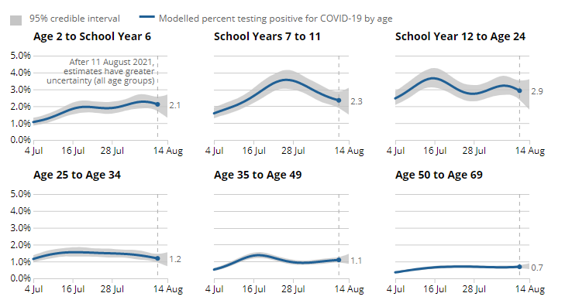
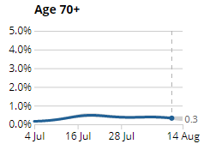
Infections by age group, England
Estimated % of population testing positive for COVID-19 by age group
Highlight:
Estimated % infection rates differ according to age group. In the past week, infection rates have decreased for School Year 7 to School Year 11, those aged 25 to 34 years and aged 70 and over. The trend is uncertain in all other age groups.
Source: ONS COVID-19 Infection Survey

Slide 7
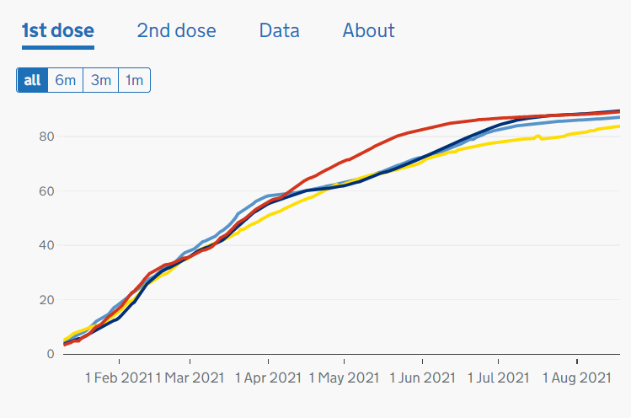
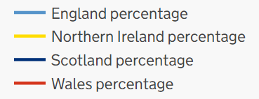
Cumulative vaccination coverage by nation
Highlight:
As of 18 August, 47,460,526 people in the UK have received their first vaccine and 41,157,069 have received their second. ​
​
Just over 87% of those eligible have now received their first dose, while over 75% have received their second dose.
Note: This figure previously included over 18s only, but now includes all eligible people aged 16 and over.
First Dose Coverage across UK: 10 Jan – 18 August
- 87.1%
- 89.4%
- 83.8%
- 89.1%
Source: Gov.uk, Vaccinations in United Kingdom

Slide 8
Vaccination coverage, UK
Highlight:
Since April, there has been a higher level of administration of second doses compared to first doses. Vaccination rates have slowed in recent weeks.
Number of vaccinations given across the UK: 11 Jan – 18 August
Source: Gov.uk, Vaccinations in United Kingdom (BMA graph)

Slide 9
Vaccination coverage by age group, England
Highlight:
Latest NHSE data covers vaccinations up to 15 August. First dose coverage is high across age groups, with rates continuing to rise steadily among younger age groups, though uptake has slowed in recent weeks.
Source: NHS England, COVID-19 Vaccination

Slide 10
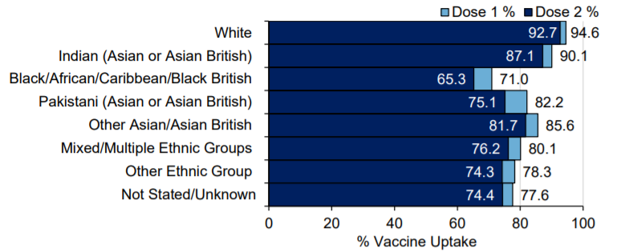
COVID-19 Vaccine uptake in England, by ethnicity
Cumulative weekly COVID-19 vaccine uptake by ethnicity in England those aged 50 and over
Highlight:
Latest PHE data covers vaccination uptake up to 15 August.
Take up for those aged 50 and over is higher in White and Indian groups, and lowest in Black/African/Caribbean/Black British groups. This remains a concern and there are attempts to improve uptake, for example, through outreach activities.
Source: Gov.uk, PHE Surveillance Report

Slide 11
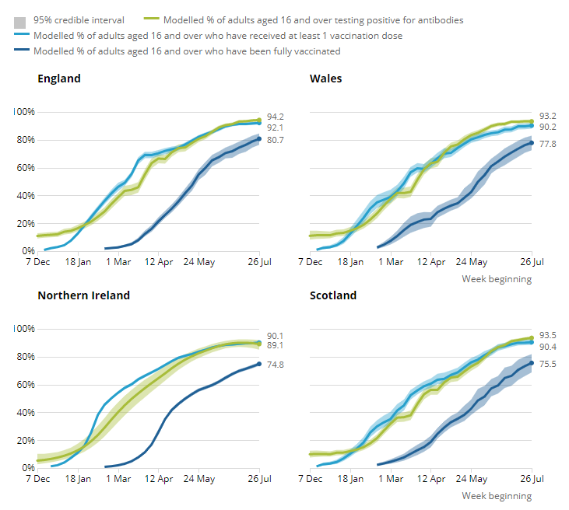
ONS infection survey antibody & vaccination data
Highlight:
Latest ONS infection survey antibody data runs up to 24 July and shows the detection of antibodies to COVID-19 has levelled out.
Next release: 1 September 2021
Nation | % Est adult pop who would have tested positive for anti-bodies to COVID-19 | % Previous data
England | 94.2 | 93.6
Wales | 93.2 | 93.2
Scotland | 93.5 | 92.5
N Ireland | 89.1 | 90.7
Source: ONS COVID-19 Infection Survey Antibody and Vaccination data

Slide 12
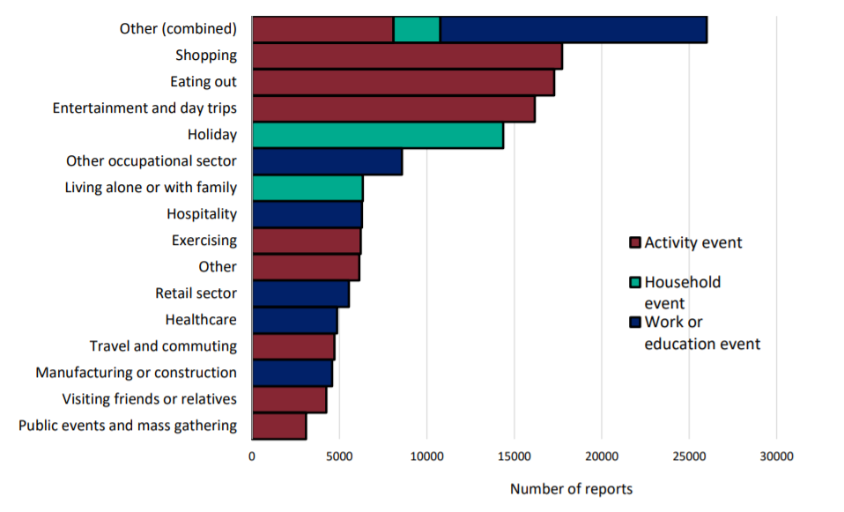
Community surveillance, England
Highlight:
‘Shopping’, ‘Eating out’ and ‘Entertainment and day trips’ are the most commonly reported activities prior to testing positive.
Events and activities reported by people testing positive, prior to symptom onset, week 32
*Reported activity does not necessarily determine that transmission occurred during this activity.
Source: National flu and COVID-19 surveillance graph

Slide 13
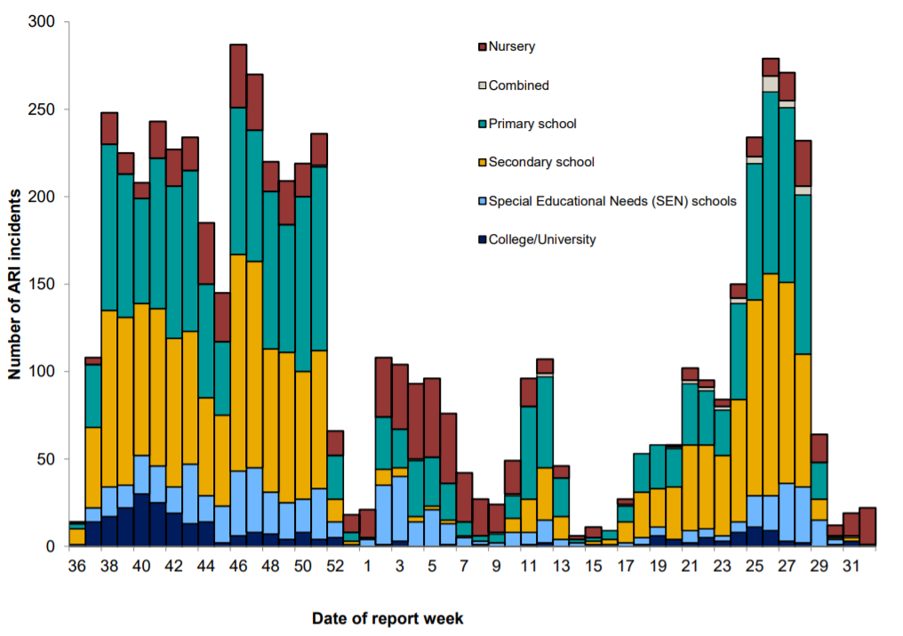
Community surveillance, England
Highlight:
The number of ARI cases reported had steadily increased since schools reopened on 19 April. However, cases have declined in all groups except nurseries since the beginning of the school holidays.
Number of ARI incidents or outbreaks by type of educational setting, England
Source: National flu and COVID-19 surveillance graph

Slide 14
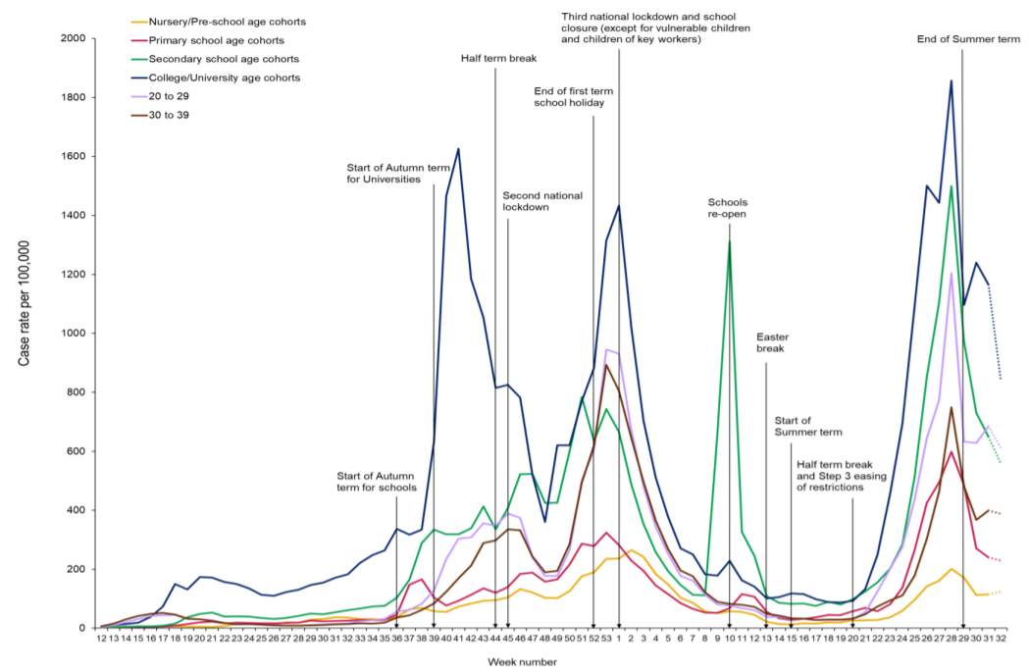
Community surveillance, England
Highlight:
COVID-19 cases have reduced in most educational settings.
The reported number of cases for all age cohorts remain higher than the number of confirmed cases seen over summer 2020.
Weekly incidence of lab confirmed COVID-19 cases per 100,000 in nursery, primary school, secondary school and college/university cohorts
Source: National flu and COVID-19 surveillance graph

Slide 15
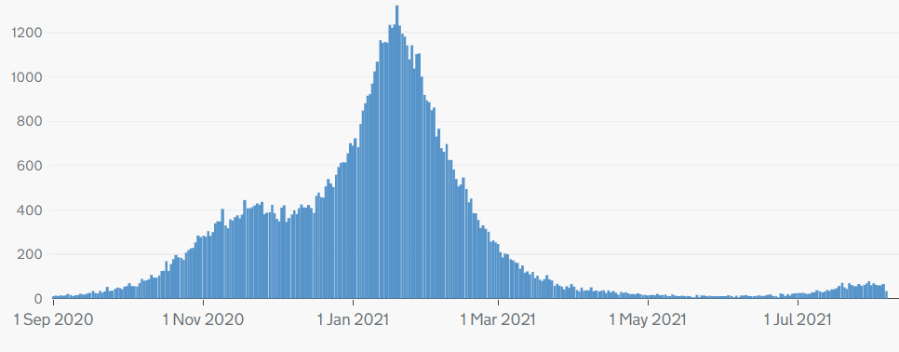
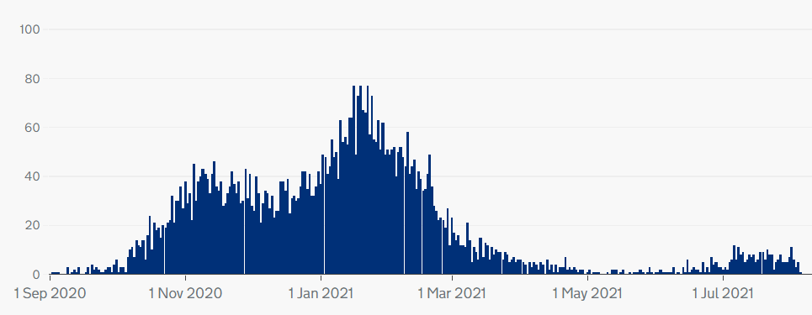
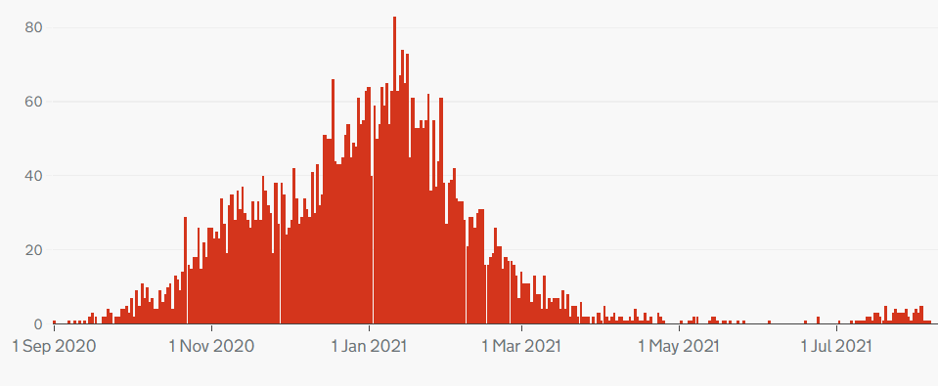
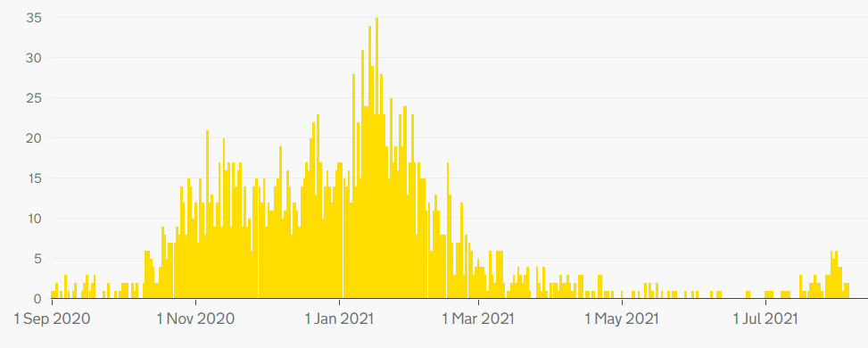
COVID-19 deaths, UK
Highlight:
The number of deaths with COVID-19 listed on the death certificate has levelled out across the UK.
Note: different scales – but overall trend is similar across nations.
Cumulatively, as of 8 August, 154,811 people have died of COVID-19 in the UK.
Daily deaths with COVID-19 on the death certificate
England
Scotland
Wales
Northern Ireland
Source: Gov.uk COVID-19 dashboard

Slide 16
COVID-19 deaths by age, England and Wales
Highlight:
Deaths remain low across all age groups, but has increased slightly among over 85s in recent weeks.
Deaths per 100,000 by age group (England and Wales)
Source: ONS, Deaths registered weekly in England and Wales, provisional

Slide 17
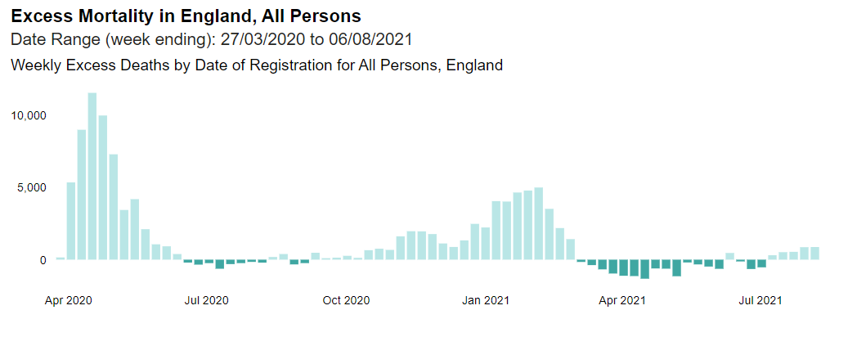
Excess deaths, England
Highlight:
Excess deaths have fallen since April 2021. Latest figures for the week ending 6 August indicate that there have been 93,942 excess deaths since March 2020.
Excess deaths = registered deaths – expected deaths
Source: PHE, Excess mortality in England

Slide 18
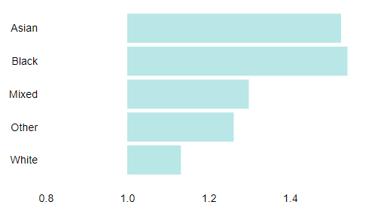
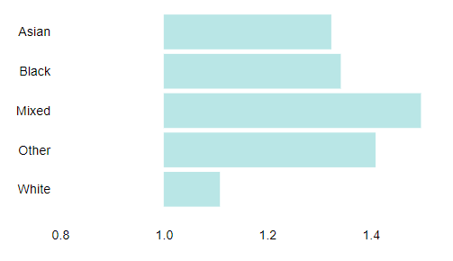
Excess deaths by ethnicity
Highlight:
The ratio of registered deaths to expected deaths is much higher among men and women of Asian and Black ethnicities compared to deaths in White groups.
Ratio of registered deaths to expected deaths for ethnic groups
in England 27 March 2020 – 30 July 2021
Males
Females
Source: PHE, Excess mortality in England

Slide 19
Hospitalisations
Patients in hospital with COVID-19, UK
Highlight:
​Hospitalisations have stabilised in recent weeks and are well below the peak in mid-January.​
​
As of 18 August, there were 6,379 people in hospital with COVID-19, with 909 patients in mechanical ventilation beds. The 7-day rolling average is below what it was at the height of the first wave, and below the level seen at the beginning of the second and third waves.
Patients with COVID-19 in mechanical ventilation beds, UK
Source: Gov.uk COVID-19 dashboard

Slide 20
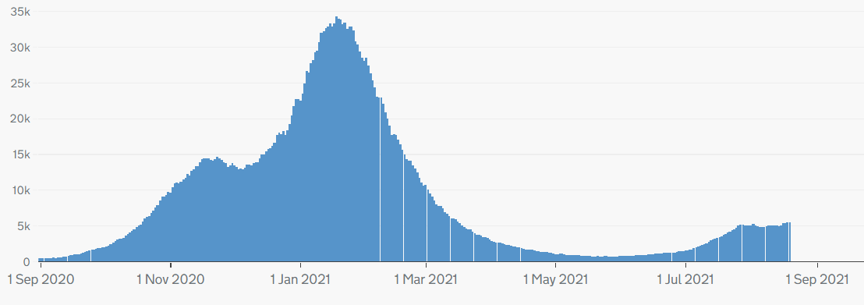
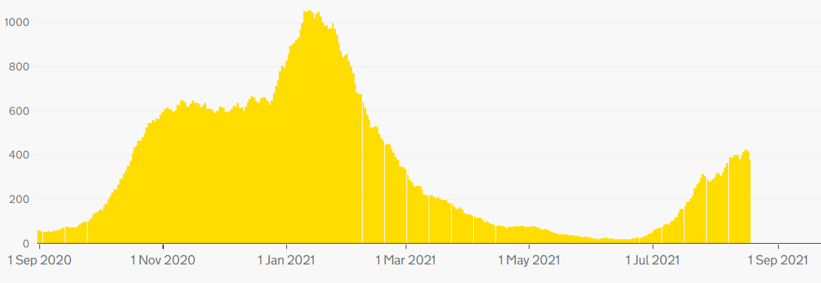
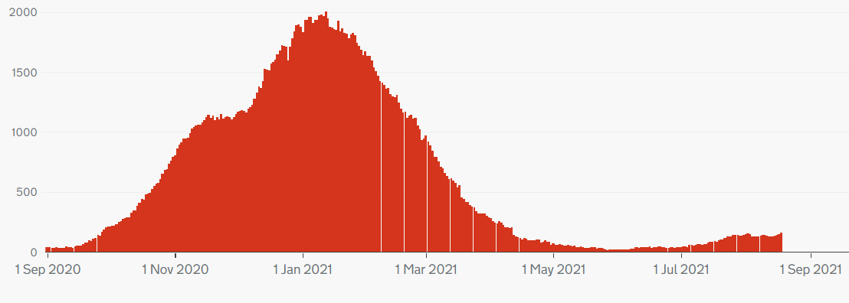
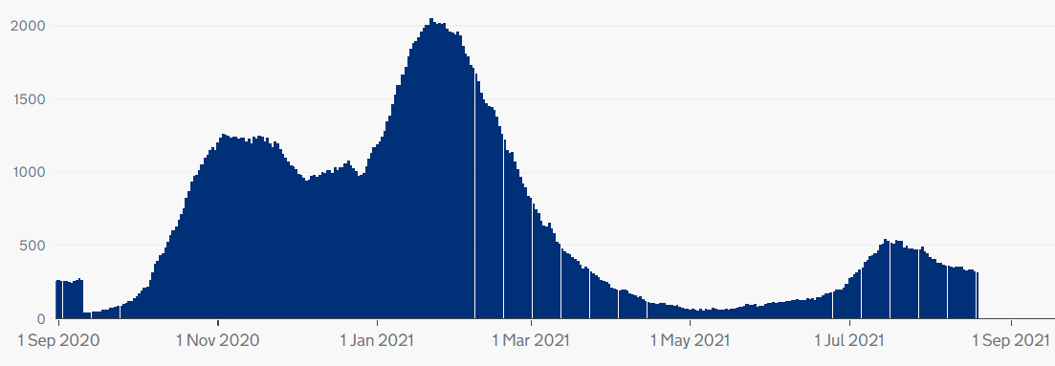
Hospitalisation trends, UK
Note: different scales – but overall trend similar across UK nations.
England
Northern Ireland
Wales
Scotland
Source: Gov.uk COVID-19 dashboard

Slide 21
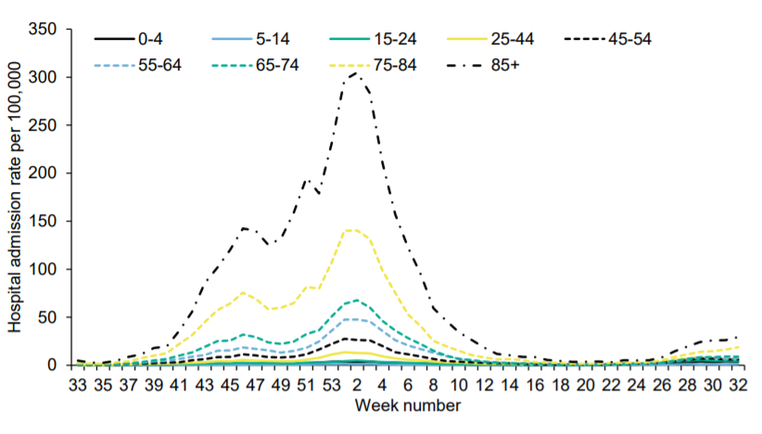
Hospital admissions by age
Highlight:
Hospital admissions for all age groups remain low.
Weekly hospital admissions by age group
Source: National flu and COVID-19 surveillance report

Slide 22
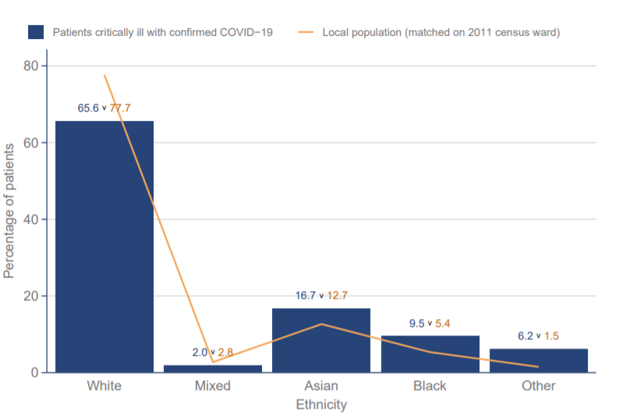
ICNARC data - ethnicity
Highlight:
Data from the Intensive Care National Audit and Research Centre (ICNARC) shows that those from Asian and Black ethnic backgrounds make up a disproportionate percentage of patients critically ill with COVID-19 (compared to their proportion in local populations).
Ethnicity distribution compared to local population - patients critically ill with COVID-19 admitted from 1 Sept 2020
Source: ICNARC report on COVID-19 in critical care (UK)

Slide 23
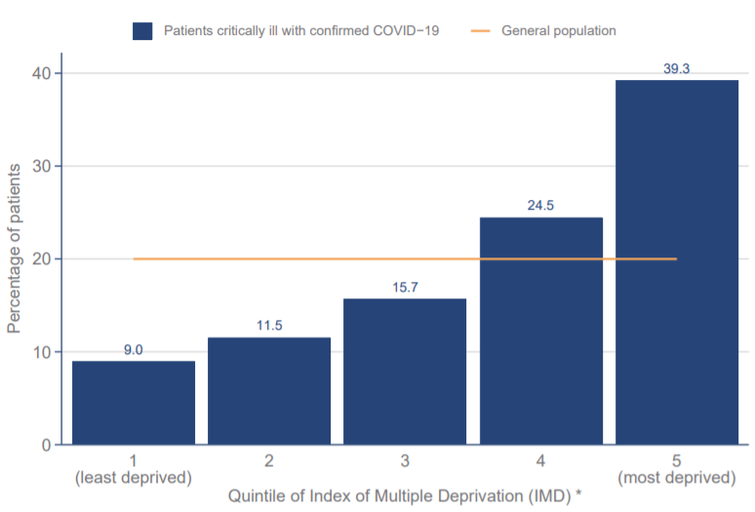
ICNARC data - deprivation
Highlight:
ICNARC data on deprivation shows those from more deprived backgrounds make up a disproportionate percentage of patients critically ill with COVID-19.
Index of Multiple Deprivation – distribution of patients critically ill with COVID-19 admitted since 1 September 2020 compared with general population
Source: ICNARC report on COVID-19 in critical care (UK)

Slide 24
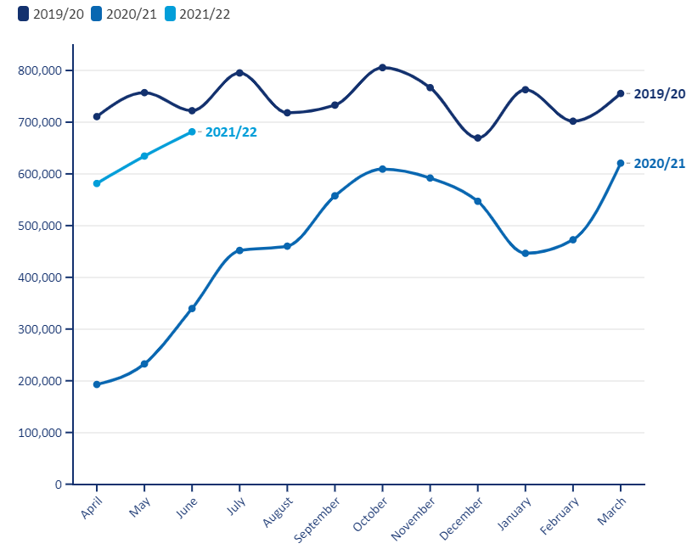
Non-COVID-19 Backlog, England
Elective procedures (all specialties) – 2019/20 versus 2020/21
Highlight:
The latest activity data shows a continued disruptive impact of COVID-19 on NHS elective care.
The BMA estimates that between May 2020 and June 2021 there were:
3.66 million fewer elective procedures
28.35 million fewer outpatient attendances.
Source: BMA analysis of NHS Digital Hospital Episode Statistics for Admitted Patient Care and Outpatient Data

Slide 25
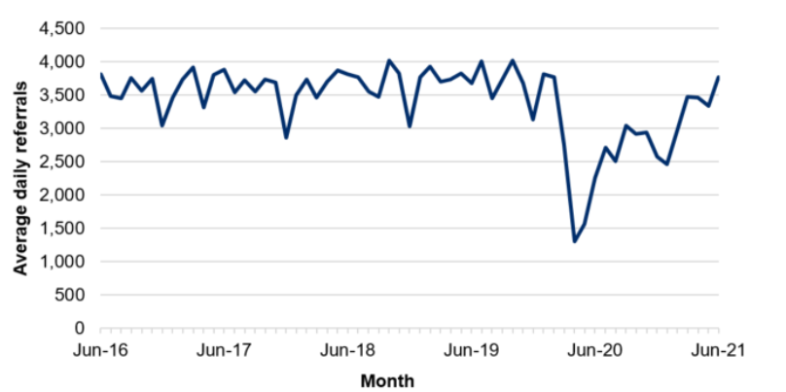
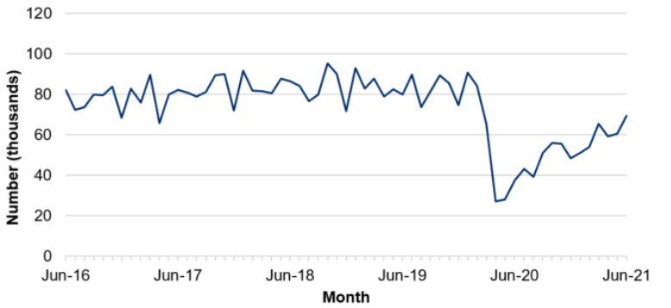
NHS pressures - Wales
Average daily number of referrals for first outpatient appointments
Highlight:
COVID-19 has caused considerable disruption to non-COVID-19 care in Wales.
The number of referrals for out-patient appointments fell sharply in the initial months of the pandemic before recovering to around 75% of expected levels over the summer of 2020. They fell again during January 2021 but are now recovering.
The number of closed patient pathways also fell sharply during the initial months of the pandemic before starting to recover.
Next update: 23 September 2021
Number of closed patient pathways
Source: Gov.wales, NHS activity and performance summary

Slide 26
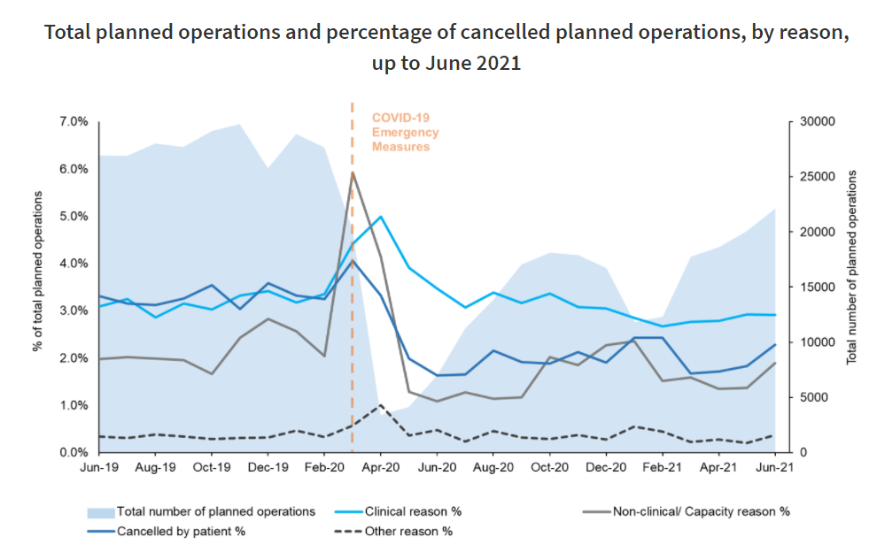
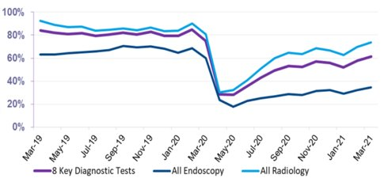
NHS pressures – Scotland
Highlight:
The latest data for June 2021 shows that elective care has not yet recovered to pre-pandemic levels.
The total number of planned operations across NHS Scotland during June 2021 increased by 9.6% compared to May 2021, but was 20.4% lower than February 2020.
Next update: September 2021
The number of patients waiting 6 weeks or less fell sharply at the beginning of the pandemic, with partial recovery over the rest of 2020. When comparing to pre-pandemic levels, the waiting list size is 19.6% higher than February 2020.​
Next update: August 2021
Source: Public Health Scotland, Cancelled planned operations
Percentage of patients waiting 6 weeks or less at month end, by test type
Source: Public Health Scotland, NHS waiting times - diagnostics

Slide 27
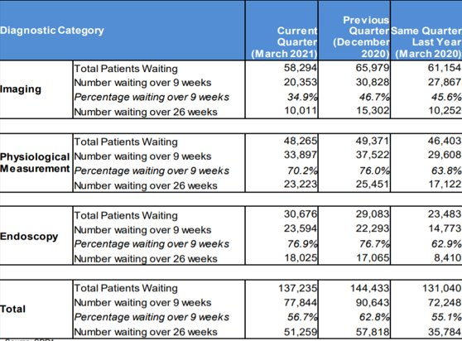
NHS pressures – Northern Ireland
Highlight:
COVID-19 has affected waiting times for diagnostic services in Northern Ireland.
The number of patients waiting over 9 weeks and over 26 weeks both rose in the Quarter up to September 2020, reflecting the disruption to services seen during the initial phases of the pandemic.
Waiting times have recovered somewhat in the Quarter ending March 2021, but remain higher than the same Quarter in 2020.
Source: Northern Ireland waiting time statistics: diagnostic waiting times

