Slide 1
Weekly COVID-19 data update
11/06/2021
Contact: Alanna Wurm, Policy Advice and Research Officer, Public Health and Healthcare
awurm@bma.org.uk

Slide 2
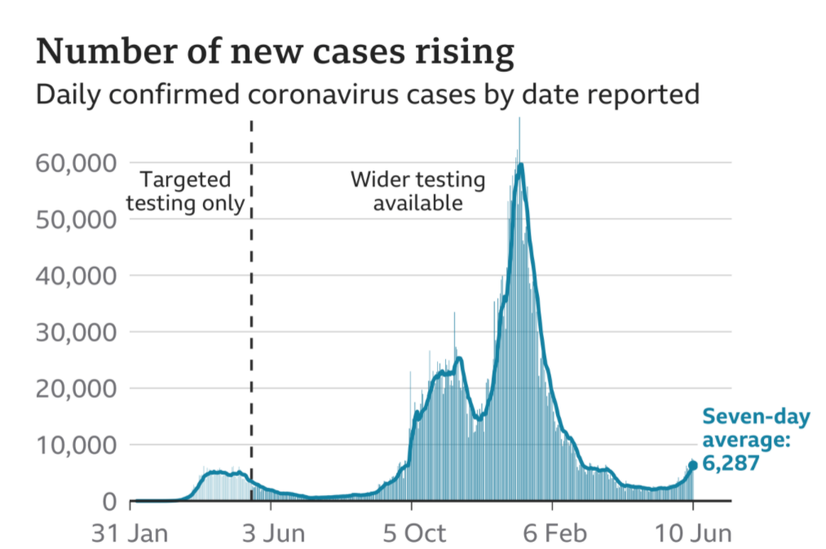
Cases – UK wide
Highlight:
Latest figures indicate there were 7,393 confirmed cases across the UK reported on 10 June. This compares to 5,274 new cases reported in the last update (3 June). ​
​
The graph indicates that the number of new cases are rising, with a seven-day average of 6,287. Cases are higher than in summer 2020, but substantially lower than the start of the year.
Source: Gov.uk COVID-19 dashboard (graph via BBC)

Slide 3
Cases by nation (and English regions)
Highlight:
Latest figures indicate an increase in the number of cases across the UK, most notably in England and Scotland. Cases have risen across all the English regions. There continues to be considerable variation in cases per 100k between different areas, with higher figures recorded in the North of England and London.
Cases per 100,000 by English region, last 7 days
Cases per 100,000 by nation
English Region | Cases per 100k | % Change compared to last week
North West​ | 140.9 | 67%
Yorkshire and The Humber​ | 54 | 40%
London​ | 48.7 | 60%
North East​ | 37.8 | 59%
West Midlands​ | 36.4 | 61%
South East​ | 33 | 49%
East Midlands​ | 32.8 | 34%
East of England​ | 25.4 | 25%
South West​ | 18.3 | 91%
Source: Gov.uk COVID-19 dashboard (BMA graph)

Slide 4
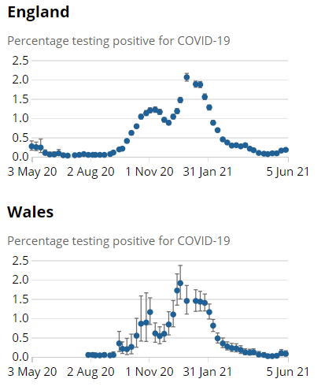
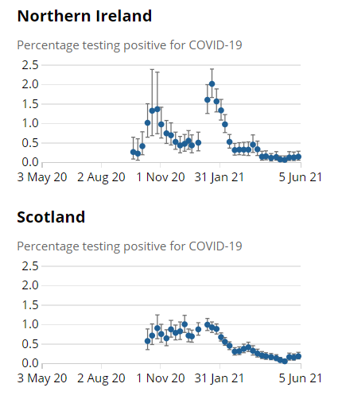
ONS infection survey data (5/06/21)
Highlight:
Latest ONS infection survey data runs up to 5 June and shows an increase in cases in most UK nations except Wales.
Nation | Estimated pop with COVID-19 | Previous week
England | 96,800​ | 85,600
Wales | 2,300​ | 2,900
Scotland | 9,700​ | 7,700
N Ireland | 2,600​ | 2,300
Source: ONS COVID-19 Infection Survey

Slide 5
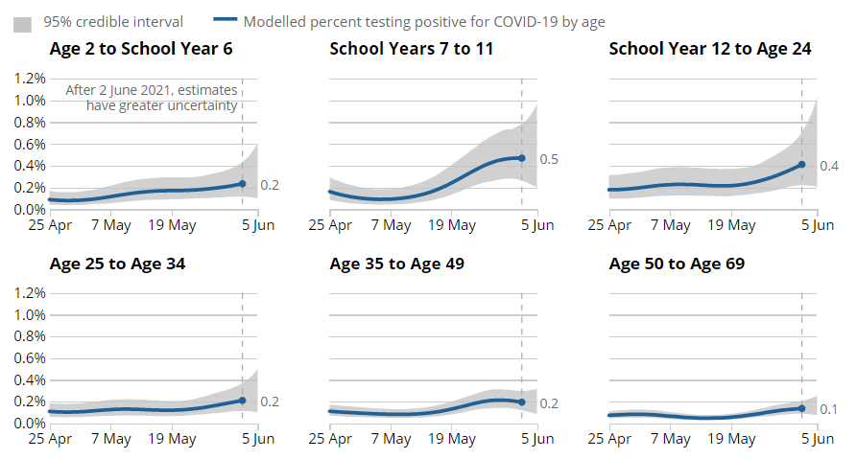
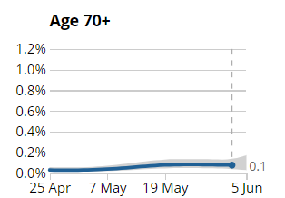
Infections by age group, England
Estimated % of population testing positive for COVID-19 by age group
Highlight:
Estimated % infection rates remain low across the population. In the past week, infection rates have increased in:​
School Year 12 to those aged 34
Those aged 50 to 69 years old
Source: ONS COVID-19 Infection Survey

Slide 6
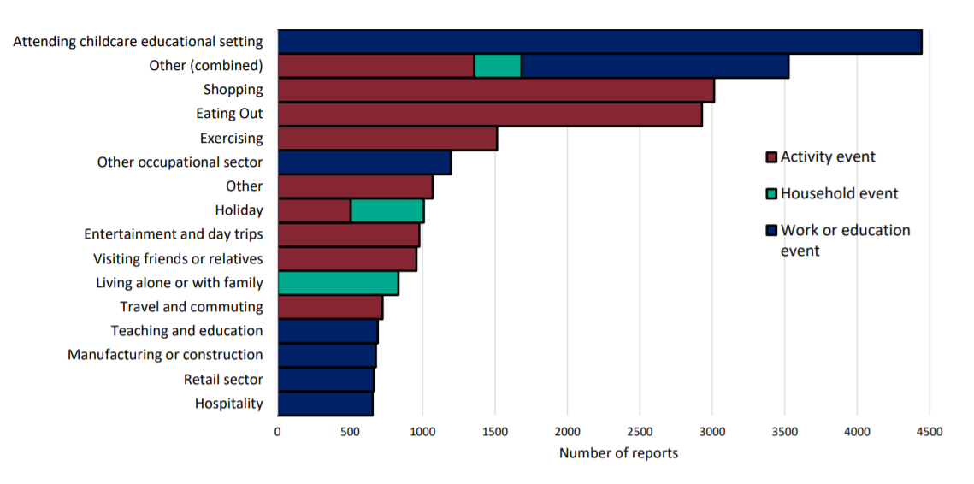
Community surveillance, England
Highlight:
‘Attending childcare educational setting’ and ‘shopping’ are the most commonly reported activity prior to testing positive.*
Reports for attending childcare setting and shopping increased this week to just under 4500 and 3000 respectively, compared to over 3500 and just under 2100 reported in week 21.
Events and activities reported by people testing positive, prior to symptom onset, week 22
*Reported activity does not necessarily determine that transmission occurred during this activity.
Source: National flu and COVID-19 surveillance graph

Slide 7
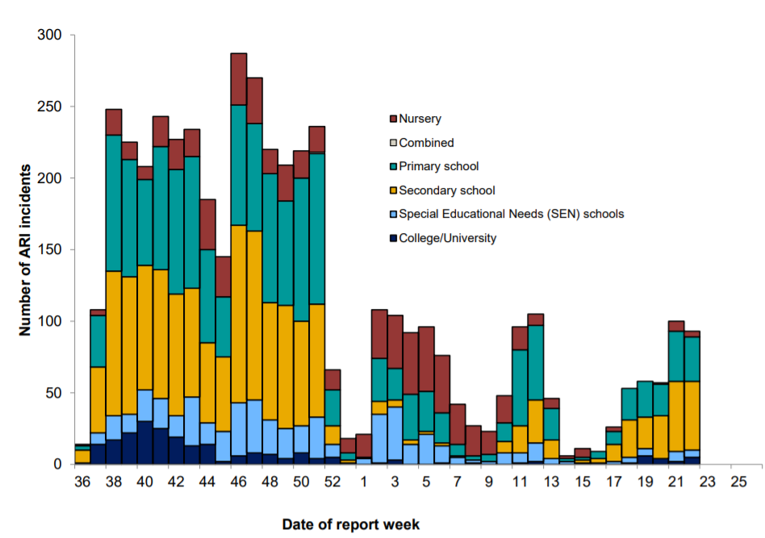
Community surveillance, England
Highlight:
The number of ARI cases reported have steadily increased since schools reopened on 19 April, particularly in primary and secondary school settings.
Number of ARI incidents or outbreaks by type of educational setting, England
Source: National flu and COVID-19 surveillance graph

Slide 8
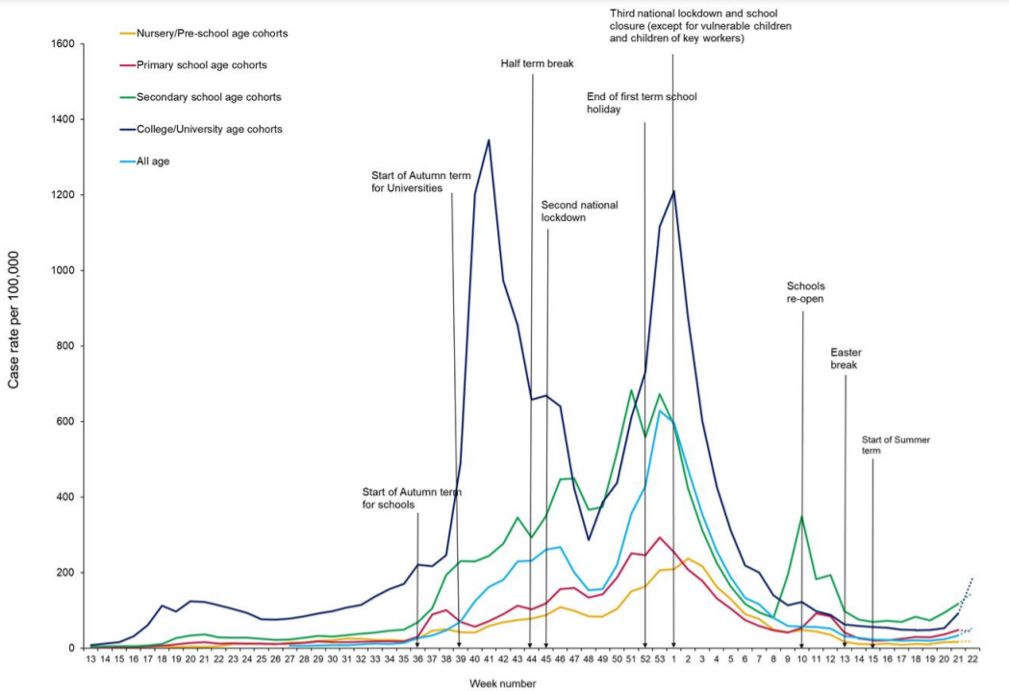
Community surveillance, England
Highlight:
COVID-19 cases are rising in all educational settings.
The reported number of cases for certain age cohorts, namely students in primary and secondary schools appear to be slightly higher than the number of confirmed cases seen over summer 2020.
Weekly incidence of lab confirmed COVID-19 cases per 100,000 in nursery, primary school, secondary school and college/university cohorts
Source: National flu and COVID-19 surveillance graph

Slide 9
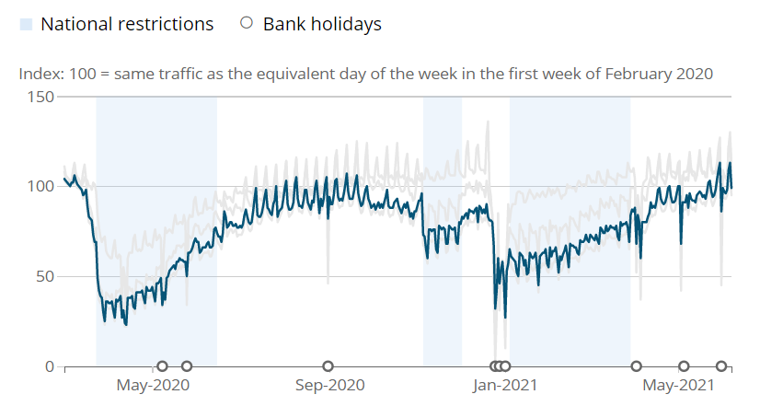
Daily road traffic
Highlight:
Road traffic on Monday 7 June 2021 was 99% of the level seen on the Monday of the first week of February 2020, an increase of almost 2 percentage points from Monday 24 May 2021.
Source: ONS, Economic activity and social change in the UK, real-time indicators

Slide 10
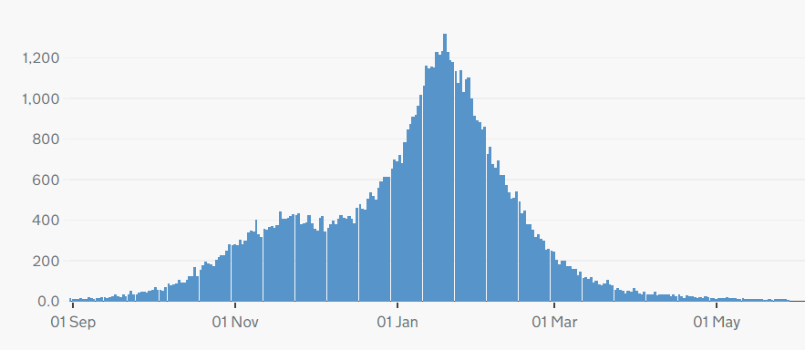
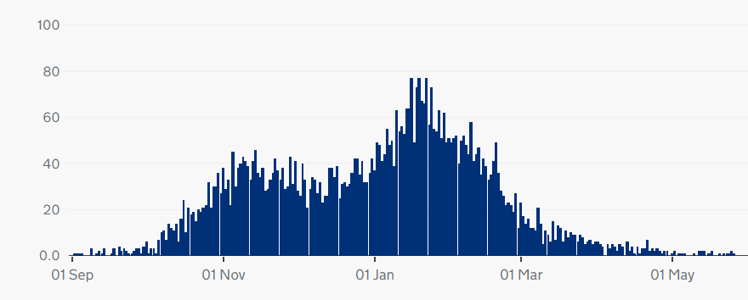
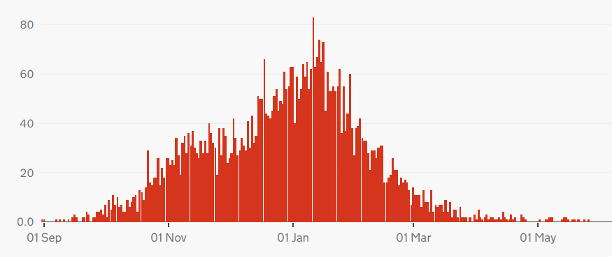
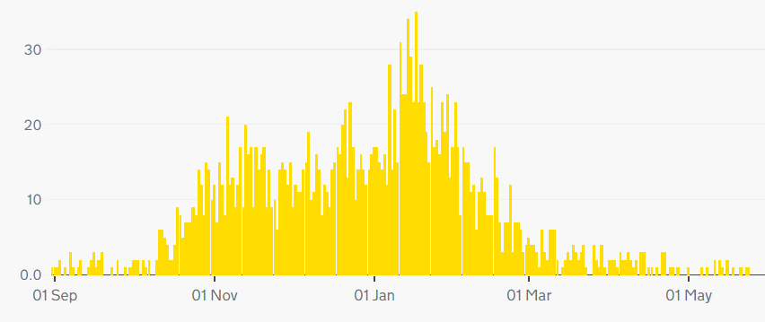
COVID-19 deaths, UK
Highlight:
The number of deaths with COVID-19 listed on the death certificate has levelled out across the UK.
Note: different scales – but overall trend is similar across nations.
Cumulatively, as of 28 May, 152,289 people have died of COVID-19 in the UK.
Daily deaths with COVID-19 on the death certificate, by date of death
England
Scotland
Wales
Northern Ireland
Source: Gov.uk COVID-19 dashboard

Slide 11
COVID-19 deaths by age, England and Wales
Highlight:
Deaths per 100,000 continue to fall across all age groups, particularly among over 65s, and remain low in other age groups.
Deaths per 100,000 by age group (England and Wales)
Source: ONS, Deaths registered weekly in England and Wales, provisional

Slide 12
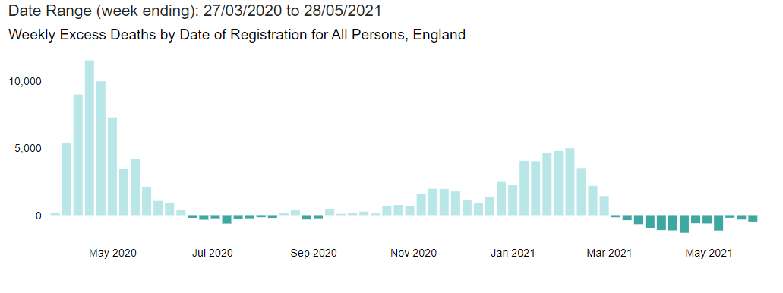
Excess deaths, England
Highlight:
Excess deaths have been falling since the beginning of April 2021. Latest figures for the week ending 28 May indicate that there have been 92,333 excess deaths since March 2020.​
Excess deaths = registered deaths – expected deaths
Source: PHE, Excess mortality in England

Slide 13
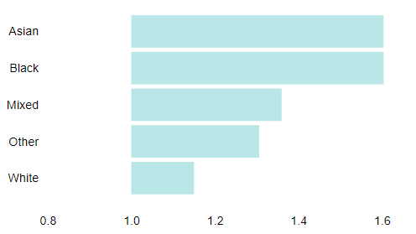
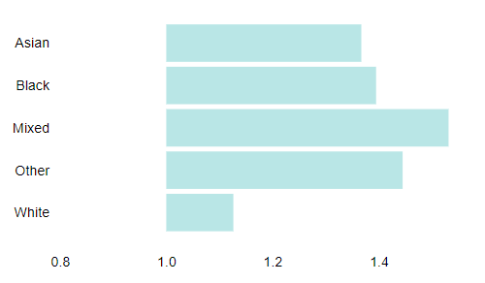
Excess deaths by ethnicity
Highlight:
The ratio of registered deaths to expected deaths is much higher among men and women of Asian and Black ethnicities compared to deaths in White groups.
Ratio of registered deaths to expected deaths for ethnic groups
in England 30 April – 21 May 2021
Males
Females
Source: PHE, Excess mortality in England

Slide 14
Hospitalisations
Patients in hospital with COVID-19, UK
Highlight:
​Hospitalisations have levelled out since the recent peak in mid-January and are reaching similar levels to those seen in September 2020. ​
​
As of 8 June, there were 1,049 people in hospital with COVID-19, with 158 patients in mechanical ventilation beds. The 7-day rolling average is below what it was at the height of the first wave, and below the level seen at the beginning of the second and third waves.
Patients with COVID-19 in mechanical ventilation beds, UK
Source: Gov.uk COVID-19 dashboard

Slide 15
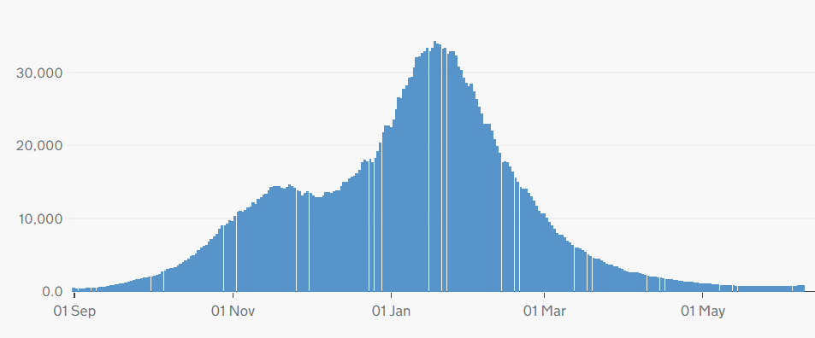
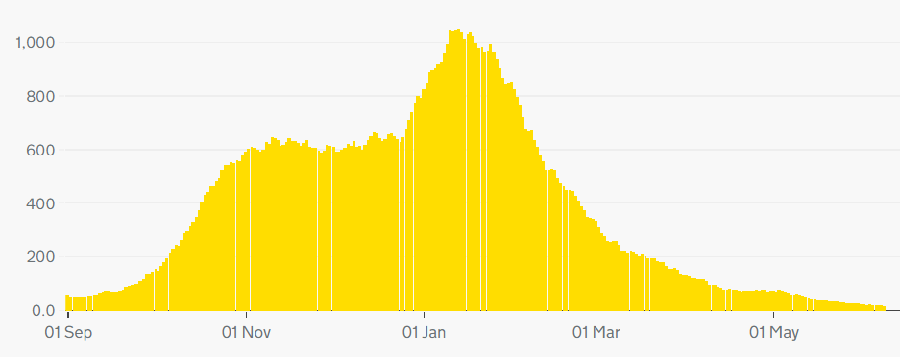
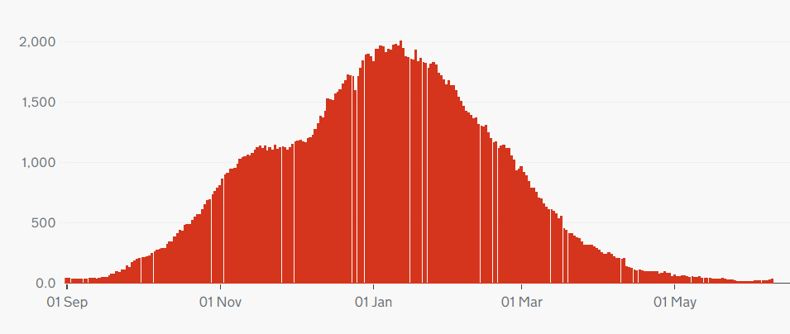
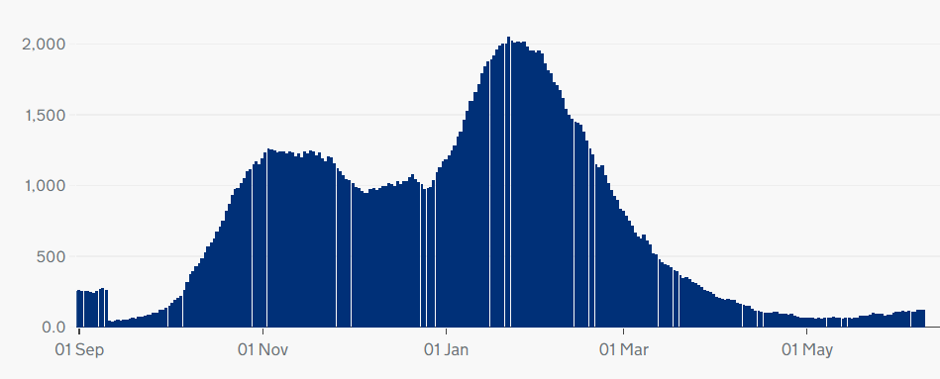
Hospitalisation trends, UK
Note: different scales – but overall trend similar across UK nations.
England
Northern Ireland
Wales
Scotland
Source: Gov.uk COVID-19 dashboard

Slide 16
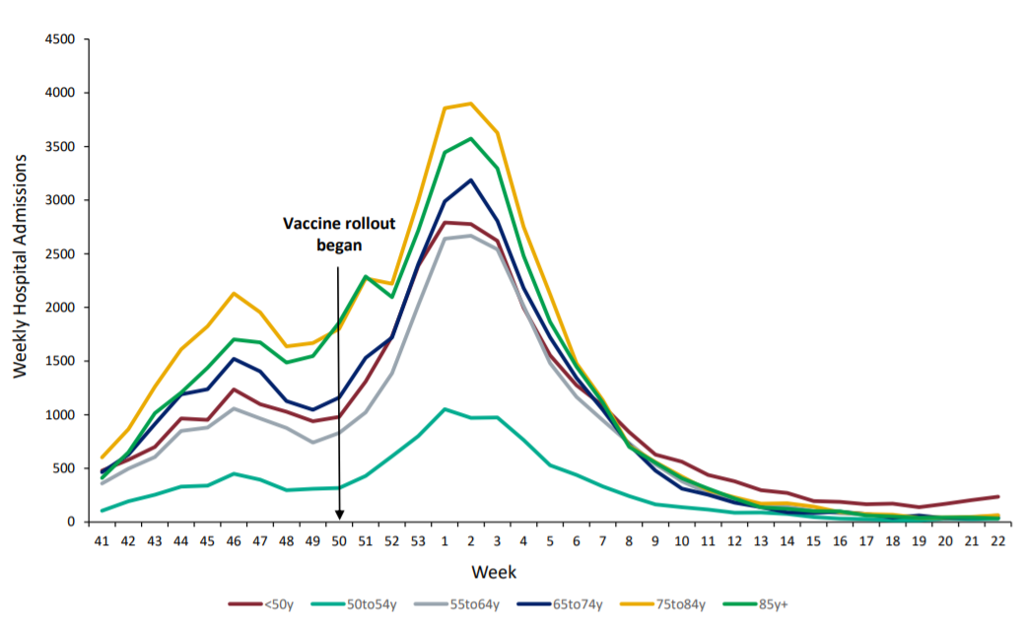
Hospital admissions by age
Highlight:
Hospital admissions for all age groups remain low, though rates are increasing slightly among under 50s.
Weekly hospital admissions by age group
Source: National flu and COVID-19 surveillance report

Slide 17
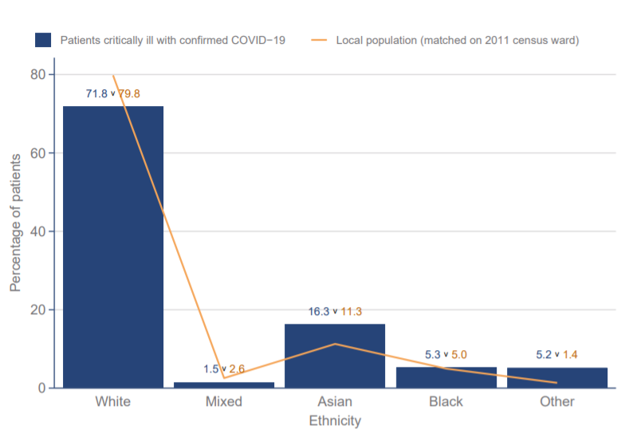
ICNARC data - ethnicity
Highlight:
Data from the Intensive Care National Audit and Research Centre (ICNARC) shows that those from Asian and Black ethnic backgrounds make up a disproportionate percentage of patients critically ill with COVID-19 (compared to the proportion of Asian and Black people in local populations).
Ethnicity distribution compared to local population - patients critically ill with COVID-19 admitted from 1 Sept 2020
Source: ICNARC report on COVID-19 in critical care (UK)

Slide 18
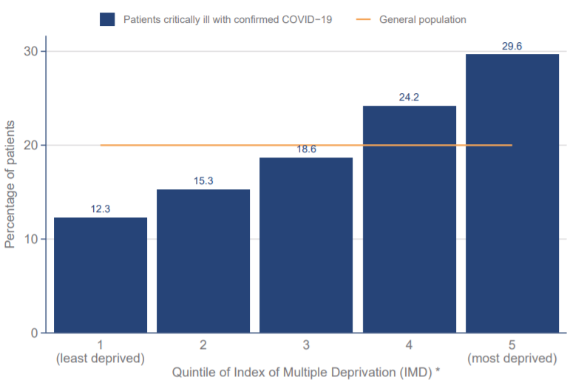
ICNARC data - deprivation
Highlight:
ICNARC data on deprivation shows those from more deprived backgrounds make up a disproportionate percentage of patients critically ill with COVID-19.
Index of Multiple Deprivation – distribution of patients critically ill with COVID-19 admitted since 1 September compared with general population
Source: ICNARC report on COVID-19 in critical care (UK)

Slide 19
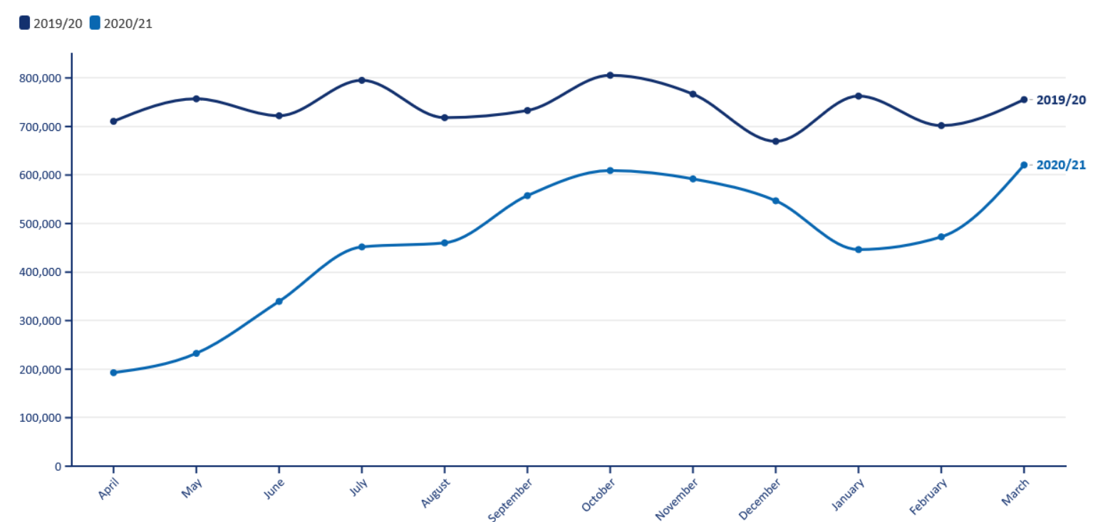
Non-COVID-19 Backlog, England
Elective procedures (all specialties) – 2019/20 versus 2020/21
Highlight:
The latest activity data for February and March shows a continued disruptive impact of COVID-19 on NHS elective care.
The BMA estimates that between April 2020 and March 2021 there were:
3.37 million fewer elective procedures
21.4 million fewer outpatient attendances.
Next backlog stats update: 24 June
Next pressures update: 8 July
Source: BMA analysis of NHS Digital Hospital Episode Statistics for Admitted Patient Care and Outpatient Data

Slide 20
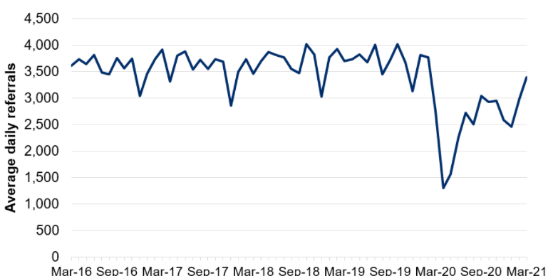
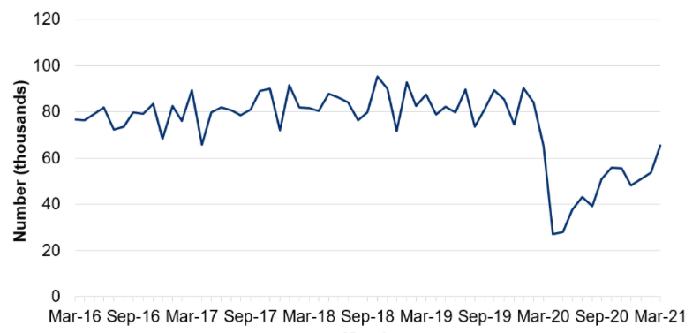
NHS pressures - Wales
Average daily number of referrals for first outpatient appointments
Highlight:
COVID-19 has caused considerable disruption to non-COVID-19 care in Wales.
The number of referrals for first out-patients appointments fell sharply in the initial months of the pandemic before recovering to around 75% of expected levels over the summer of 2020. They fell again during January 2021 but are now recovering.
The number of patient pathways open also fell sharply during the initial months of the pandemic before starting to recover.
Next update: 17 June 2021
Number of closed patient pathways
Source: Gov.wales, NHS activity and performance summary

Slide 21
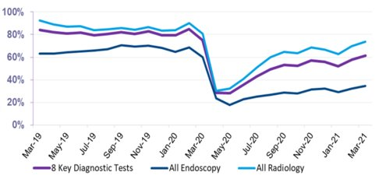
NHS pressures – Scotland
Total Number of scheduled elective operations in theatre system
Highlight:
Scheduled elective operations in the NHS in Scotland reduced sharply at the beginning of the pandemic before recovering slightly over the summer, and beginning to fall again towards the end of 2020. The latest data for April 2021 shows that elective care has not yet recovered to pre-pandemic levels.
Since April 2020, there have been 143k fewer elective operations than would normally be expected (based on 2019 trends).
Next update: July 2021
The number of patients waiting 6 weeks or less fell sharply at the beginning of the pandemic, with partial recovery over the rest of 2020. When comparing to pre-pandemic levels, the waiting list size is 19.6% higher than 28 February 2020.​
Next update: August 2021
Source: Public Health Scotland, Cancelled planned operations
Percentage of patients waiting 6 weeks or less at month end, by test type
Source: Public Health Scotland, NHS waiting times - diagnostics

Slide 22
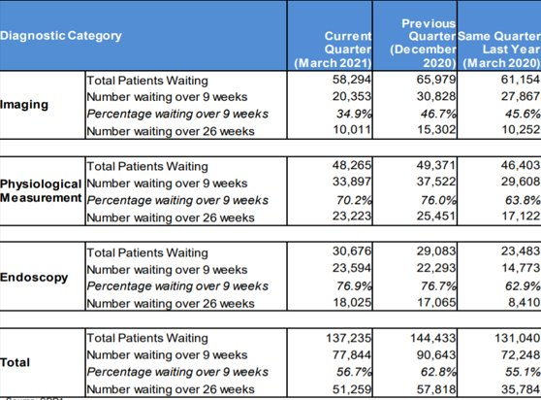
NHS pressures – Northern Ireland
Highlight:
COVID-19 has affected waiting times for diagnostic services in Northern Ireland.
The number of patients waiting over 9 weeks and over 26 weeks both rose in the Quarter up to September 2020, reflecting the disruption to services seen during the initial phases of the pandemic.
Waiting times have recovered somewhat in the Quarter ending March 2021, but remain higher than the same Quarter in 2020.
Source: Northern Ireland waiting time statistics: diagnostic waiting times

Slide 23
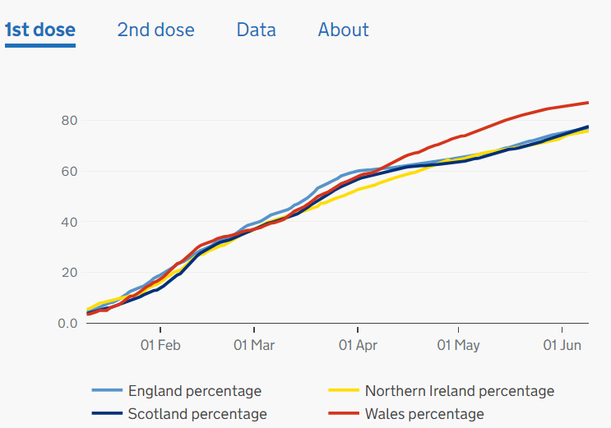
Cumulative vaccination coverage by nation
Highlight:
As of 9 June, 40,886,878 people in the UK have received their first vaccine. ​
​
Over 77% of adults have now received their first dose.
​
The Welsh vaccination programme continues to surge ahead, vaccinating over 87% of the eligible population.
First Dose Coverage across UK: 10 Jan – 9 June
- 77.7%
- 75.8%
- 77.6%
- 87%
Source: Gov.uk, Vaccinations in United Kingdom

Slide 24
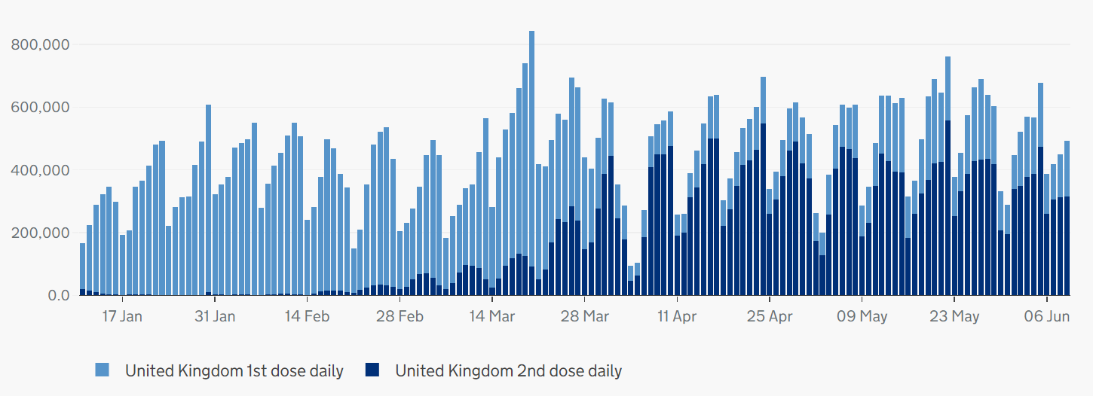
Vaccination coverage, UK
Highlight:
In recent weeks, there has been a higher level of administration of second doses compared to first doses. The total number of vaccines administered are lower than levels seen in March, but progress is being made.
Number of vaccinations given across the UK: 11 Jan – 9 Jun
Source: Gov.uk, Vaccinations in United Kingdom (BMA graph)

Slide 25
Vaccination coverage by age group, England
Highlight:
Latest NHSE data covers vaccinations up to 10 June.
First dose coverage is high across age groups. Over 90% of over 50s have received a first dose, and rates are increasing among younger groups.
Rate of delivery for second doses continues to make progress, with over 90% of over 60s now having received a second dose.
Proportion of population vaccinated by age group
Source: NHS England, COVID-19 Vaccination

Slide 26
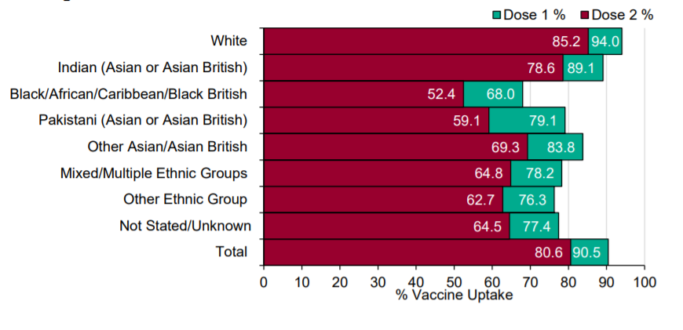
COVID-19 Vaccine uptake in England, by ethnicity
Cumulative weekly COVID-19 vaccine uptake by ethnicity in England those aged 50 and over
Highlight:
Latest PHE data covers vaccination uptake up to 6 June.
Take up for those aged 50 and over is higher in White and Indian groups, and lowest in Black/African/Caribbean/Black British groups. This remains a concern and there are attempts to improve uptake, for example, through outreach activities.
Source: Gov.uk, PHE Surveillance Report

