Slide 1
Does General Practice have a future in the NHS?
Richard Vautrey
Chair, GPC England

Slide 2
The Health and Care Bill
Significant reform of the 2012 Act
Section 75 to be removed – ending mandated competitive tendering
ICSs to be formalised as statutory bodies
CCGs to be absorbed into ICSs
NHS bodies within ICSs bound by the Triple Aim – Improve health, better care, reduce costs
LETBs (Local Education Training Boards) will be abolished
Greater powers for the Secretary of State.

Slide 3
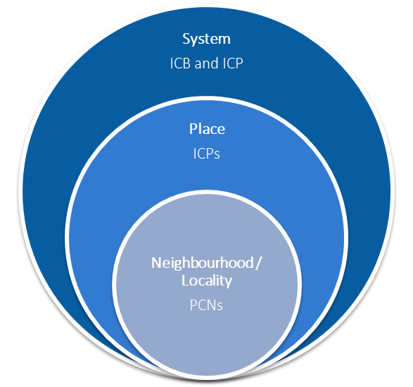
Key changes: NHS/ICS structure
ICSs will become statutory bodies – formalising their role and accountability for the planning and provision of care
ICSs will be formed of two parts:
Integrated Care Body (ICB) / ICS NHS body, focused on core NHS services
Integrated Care Partnership (ICP) / ICS Partnership, focused on wider issues e.g. public health and social care
NHS bodies will be bound together by the Triple Aim.
ICP/"place" should be where key discussion and decisions made for general practice

Slide 4
Key changes: CCGs
CCGs and powers and assets will transfer to ICSs - including GP contracts
CCGs have been imperfect, but their loss could reduce local accountability, representation and clinical leadership
Clinical leadership and representation must be embedded at every level of ICSs
Most CCG staff are expected to carry over to ICSs, but have to ensure that vital local expertise and relationships are not lost
Lobbied for existing CCG agreements with GPs and practices to be carried over to ICSs.

Slide 5
Key changes: competition and procurement
Section 75 of the 2012 Act would be removed, ending the requirement for commissioners to competitively tender NHS and public health contracts
The replacement system would broadly give commissioners three options:
This should see less wasteful competition and greater stability – but safeguards are needed to ensure proper scrutiny of commissioning and avoid conflicts of interest.
Renew contracts with existing providers without the need for tendering
Offer new or existing contracts to providers without tendering
Launch a competitive tendering process for contracts where appropriate

Slide 6
Key changes: power and accountability
The Bill would give the Health Secretary new powers, including powers to:
Set (or reset) the direction of the NHS
Amend or abolish Arms Length Bodies
create new NHS Trusts
Stronger powers to intervene in service reconfigurations
New powers over data collection and storage
A duty to publish a report on the system in place for workforce planning every five years.

Slide 7
Key implications for GPs and LMCs
Clinical voice – loss of CCGs risks losing/reducing GP leadership within ICSs and may change who and how LMCs lobby locally
CCGs – while most staff will transfer into the ICS, there is a risk that leadership, relationships, and commissioning expertise may be lost
Funding – ICSs will take greater control of funding flows, but NHSEI has stressed its commitment to national contracts - we have lobbied for ringfencing of GP funding
Integration – ‘Places’ will be key within ICSs with significant powers devolved to them - but this won’t be set out in legislation, so it’s essential clinicians shape implementation
PCNs – the exact role of PCNs isn’t entirely clear, but they are seen as ‘building blocks’ of ICSs and are expected to provide representation for primary care in parts of an ICS.

Slide 9
Investment in general practice
Locally delivered (nationally negotiated) includes:
Local Incentive Schemes (GMS, PMS)
APMS Enhanced Services
Premises
PCO Administered Funds
Out of Hours
IT (incl. centrally funded IT)
Improving Access to General Practice
Estates and Technology Transformation Programme
General Practice Workforce Programmes
Other General Practice Transformation Programmes
New Models of Care
Provisional Local Authorities' Public Health Costs
National contract includes:
Global Sum/MPIG (GMS only)
Balance of PMS Expenditure
APMS Essential and Additional Services and Other Payments
Primary Care Network Participation
Quality and Outcomes Framework
Direct Enhanced Services (GMS, PMS)
Other Selected Services
GP Extended Hours Access (GMS, PMS)

Slide 10
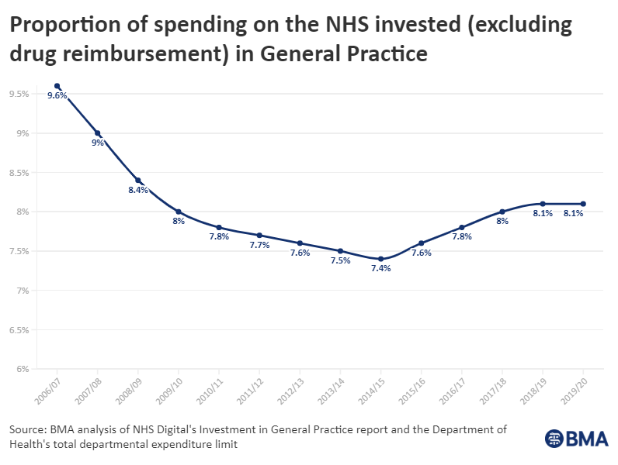

Slide 11
PCN DES – 21/22 funding
£1.76 per patient Network Participation Funding (to practices)
£1.50 per patient Core PCN Funding
£120 per bed for care home premium
ARRS increased from £430m to £746m
IIF increased from £24.25m (amended due to pandemic) to £150m
Additional £43m for PCN leadership and management
Increase to Clinical Director payment
Extended access scheme worth £454m (£87m extended hours, £367m extended access) – delayed until 2022/23

Slide 12
PCN service specifications
 | Requirements in 2021/22 | Requirements in 2022/23
Cardiovascular disease (CVD) prevention and diagnosis | From October 2021, PCNs will focus solely on improving hypertension case finding and diagnosis, where the greatest reductions in premature mortality can be made. | Requirements on PCNs to increase diagnosis of atrial fibrillation, familial hypercholesteremia and heart failure will be introduced from April 2022.
Tackling neighbourhood health inequalities | From October 2021 engage a population experiencing health inequalities within PCN area, and to codesign an intervention to address the unmet needs of this population. Delivery of this intervention will commence from March 2022. | Continued delivery of the codesigned intervention
Anticipatory care | Introduction of requirements for this service are deferred | By 30 September 2022, PCNs agree a plan for delivery of Anticipatory Care with their ICS and local partners with whom the service will be delivered jointly
Personalised care | Introduction of requirements for this service are deferred. | From April 2022 there will be three areas of focus for personalised care: further expansion of social prescribing to a locally-defined cohort which are unable or unlikely to access through established routes; supporting digitised care and support planning for care home residents; and shared decision making training. Introduction of requirements for this service are deferred.

Slide 13
PCN DES – improving the access schemes
Implementation of new access scheme arrangements delayed until April 2022, except where PCNs and CCGs have already agreed the transfer of responsibilities before then and where it still makes sense to do so
Access scheme is proposed to combine the existing Extended Hours (EH) already within the PCN DES, and the existing Extended Access (EA) which is currently commissioned locally. (£87m extended hours, £367m extended access). Some PCNs already have responsibility for both schemes
Access scheme can continue to be used to support the COVID vaccination programme
Practices could use scheme to undertake routine work at different times of the day, such as health checks, smears, immunisations, SMRs, to reduce core hours practice workload
Digital services encouraged, enabling flexible home working, and shared arrangements with neighbouring PCNs, but a GP would need to be available
Further details to be agreed between GPCE and NHSEI

Slide 14
Risks and opportunities for practices
Loss of local funding
Reduced variation in funding across ICS
Loss of voice and influence
Changes to care pathways
Shifted work
Integrated contracts
Decisions made regionally
Increased funding
Reduced variation in funding across ICS
Stronger voice, working together as providers
Development of GP-led specialist services
Closer working with specialists
Decisions made locally

