Slide 1
Weekly COVID-19 data update
23/07/2021
Contact: Alanna Wurm, Policy Advice and Research Officer, Public Health and Healthcare
awurm@bma.org.uk

Slide 2
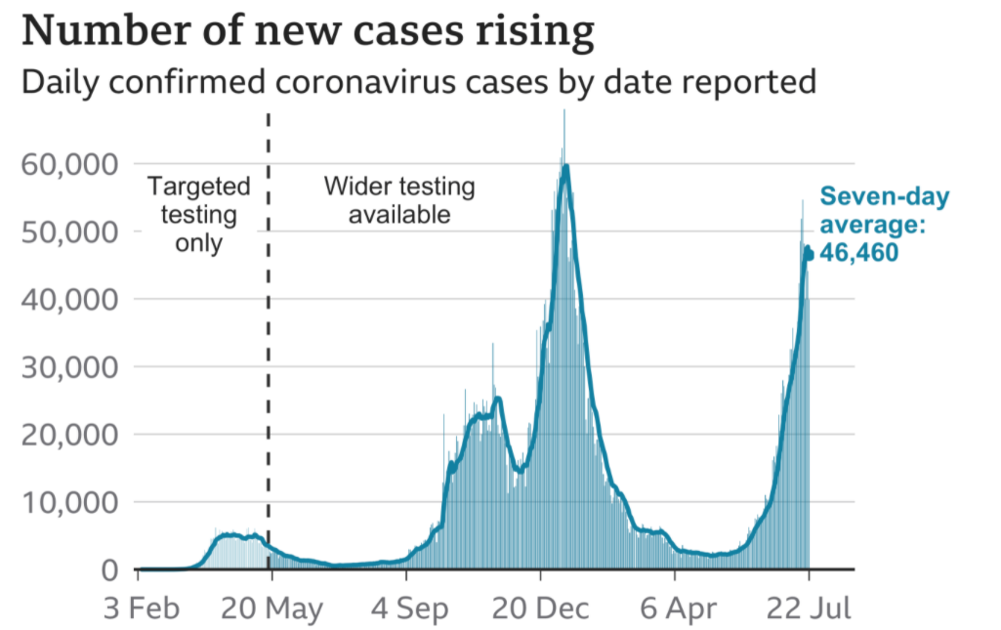
Cases – UK wide
Highlight:
There were 39,906 confirmed COVID-19 cases across the UK reported on 22 July. This compares to 48,553 new cases reported in the last update (15 July). ​
​
The number of new cases continue to rise, with a seven-day average of 46,460. This is the highest rate record since early January.
Source: Gov.uk COVID-19 dashboard (graph via BBC)

Slide 3
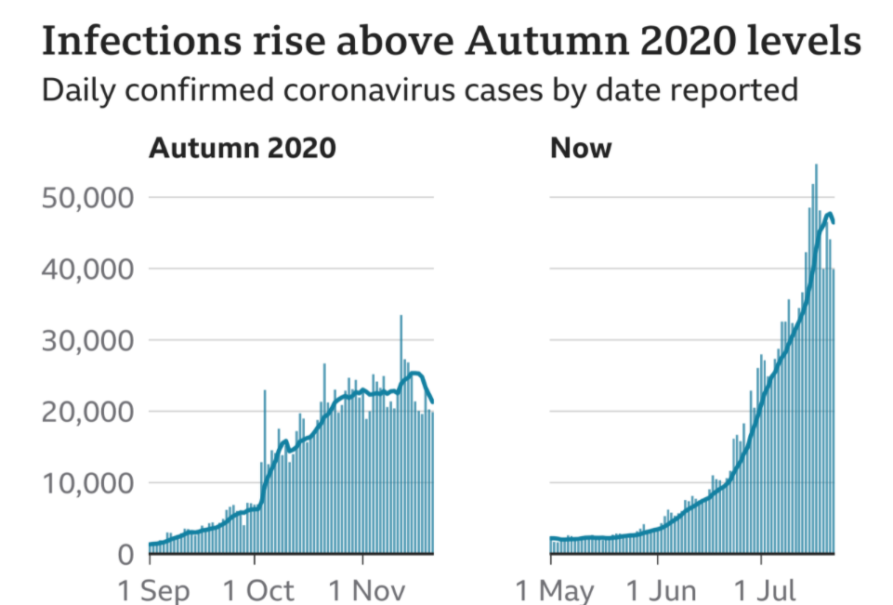
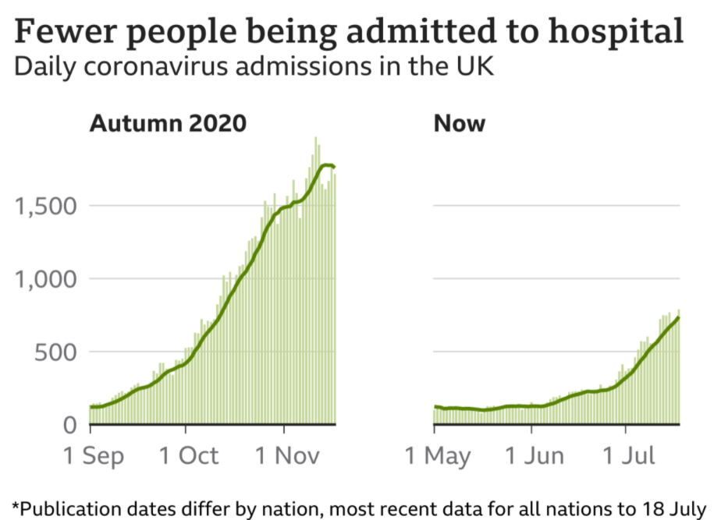
Infections and hospitalisation – UK wide
Source: Gov.uk COVID-19 dashboard (graph via BBC)

Slide 4
Cases by nation (and English regions)
Highlight:
Latest figures demonstrate an increase in the number of COVID-19 cases across the UK, except for Scotland where cases are beginning to fall. There continues to be considerable variation in cases between different areas in England, with higher figures recorded in the North of England.
Cases per 100,000 by English region, last 7 days
Cases per 100,000 by nation
English Region | Cases per 100k | % Change compared to last week
North East | 981.4 | +19%
Yorkshire and The Humber | 634.8 | +37%
North West | 599.9 | +30%
West Midlands | 551.9 | +58%
South West | 513.5 | +82%
East Midlands | 498.6 | +59%
East of England | 437.4 | +79%
London | 436.6 | +57%
South East | 426.6 | +71%
Source: Gov.uk COVID-19 dashboard (BMA graph)

Slide 5
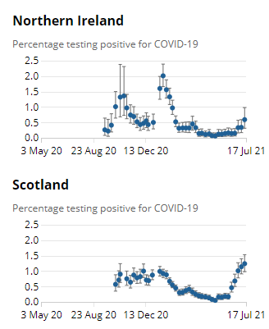
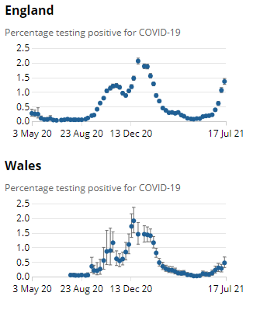
ONS infection survey data
Highlight:
Latest ONS infection survey data runs up to 17 July and shows an increase in cases in all nations.
Nation | Estimated pop with COVID-19 | Previous week
England | 741,700 | 577,700
Wales | 14,400 | 8,400
Scotland | 65,100 | 60,000
N Ireland | 10,900 | 6,300
Source: ONS COVID-19 Infection Survey

Slide 6
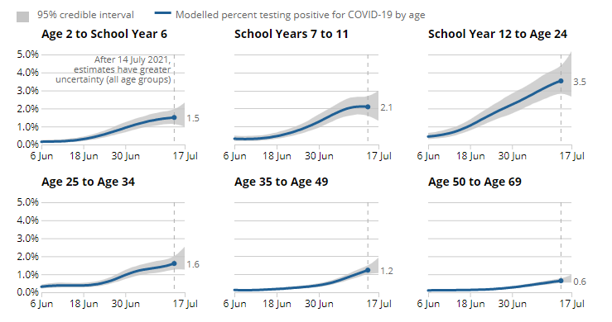
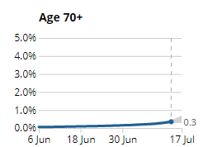
Infections by age group, England
Estimated % of population testing positive for COVID-19 by age group
Highlight:
Estimated % infection rates differ according to age group. In the past week, infection rates have increased in all age groups, most notably among younger groups.
Source: ONS COVID-19 Infection Survey

Slide 7
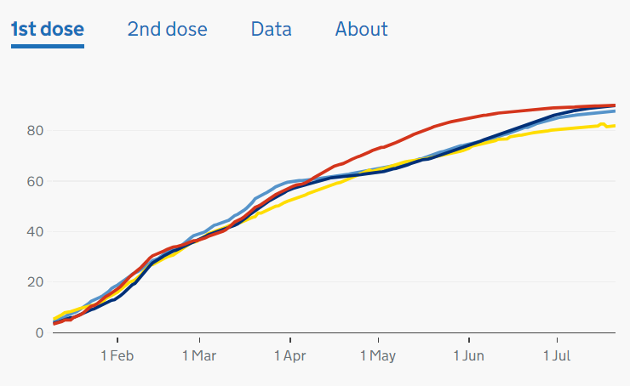
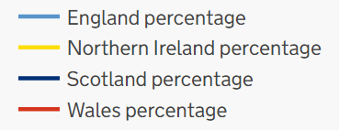
Cumulative vaccination coverage by nation
Highlight:
As of 21 July, 46,433,854 people in the UK have received their first vaccine and 36,587,904 have received their second. ​
​
Over 87% of adults have now received their first dose, while just over 69% of adults have received their second dose.
First Dose Coverage across UK: 10 Jan – 14 July
- 87.7%
- 89.9%
- 81.9%
- 90.0%
Source: Gov.uk, Vaccinations in United Kingdom

Slide 8
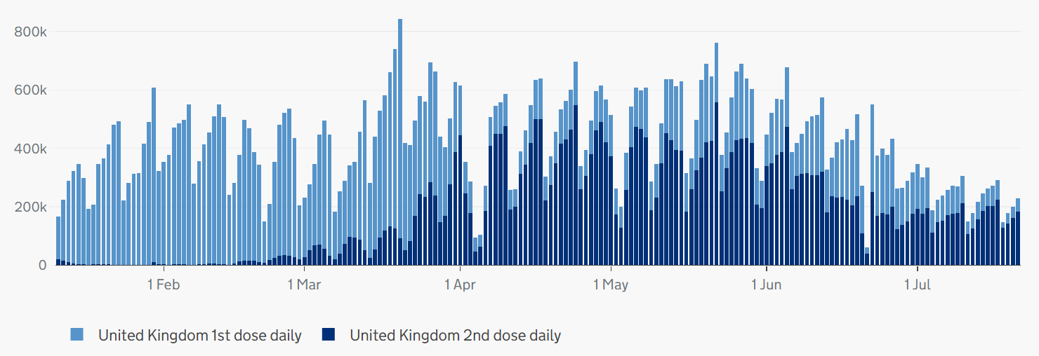
Vaccination coverage, UK
Highlight:
Since April, there has been a higher level of administration of second doses compared to first doses.
Number of vaccinations given across the UK: 11 Jan – 21 July
Source: Gov.uk, Vaccinations in United Kingdom (BMA graph)

Slide 9
Vaccination coverage by age group, England
Highlight:
Latest NHSE data covers vaccinations up to 18 July. First dose coverage is high across age groups, with rates continuing to rise steadily among younger age groups. Rate of delivery for second doses continues to make progress, with over 90% of over 50s now having received a second dose.
Source: NHS England, COVID-19 Vaccination

Slide 10
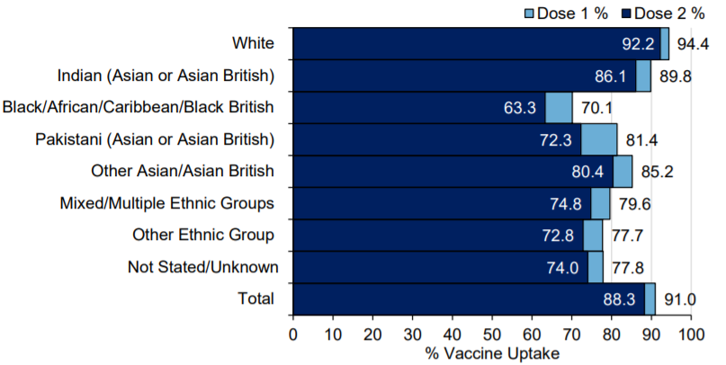
COVID-19 Vaccine uptake in England, by ethnicity
Cumulative weekly COVID-19 vaccine uptake by ethnicity in England those aged 50 and over
Highlight:
Latest PHE data covers vaccination uptake up to 18 July.
Take up for those aged 50 and over is higher in White and Indian groups, and lowest in Black/African/Caribbean/Black British groups. This remains a concern and there are attempts to improve uptake, for example, through outreach activities.
Source: Gov.uk, PHE Surveillance Report

Slide 11
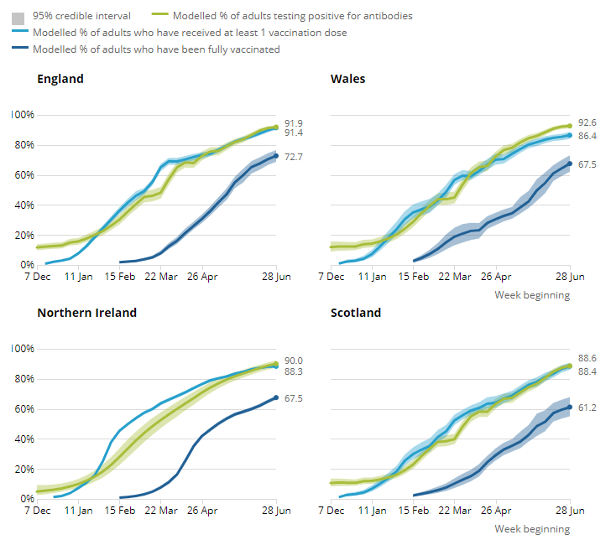
ONS infection survey antibody & vaccination data
Highlight:
Latest ONS infection survey antibody data runs up to 4 July and shows an increase in the detection of antibodies to COVID-19 .
Next release: 4 August 2021
Nation | % Est adult pop who would have tested positive for anti-bodies to COVID-19 | % Previous week
England | 91.9 | 89.8
Wales | 92.6 | 91.8
Scotland | 88.6 | 84.7
N Ireland | 90.0 | 87.2
Source: ONS COVID-19 Infection Survey Antibody and Vaccination data

Slide 12
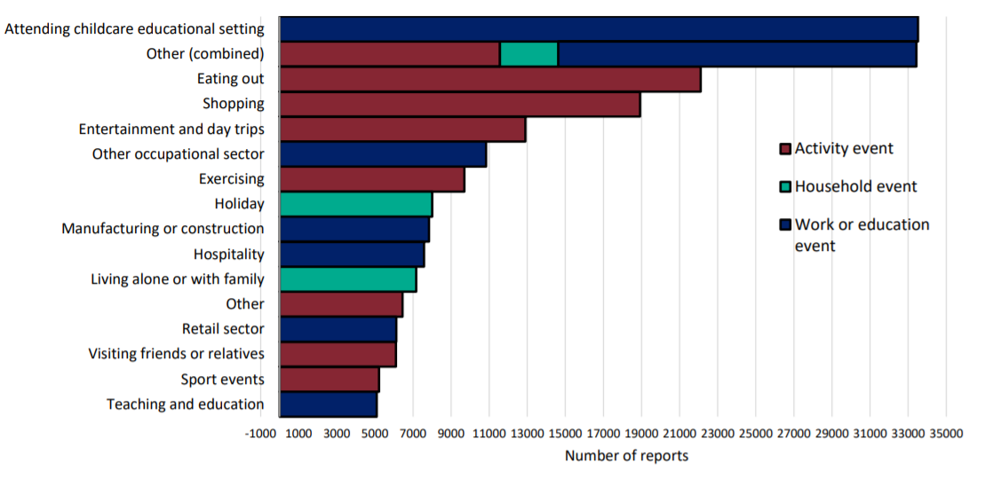
Community surveillance, England
Highlight:
‘Attending childcare educational setting’ and ‘Eating out’ are the most commonly reported activities prior to testing positive.
Events and activities reported by people testing positive, prior to symptom onset, week 28
*Reported activity does not necessarily determine that transmission occurred during this activity.
Source: National flu and COVID-19 surveillance graph

Slide 13
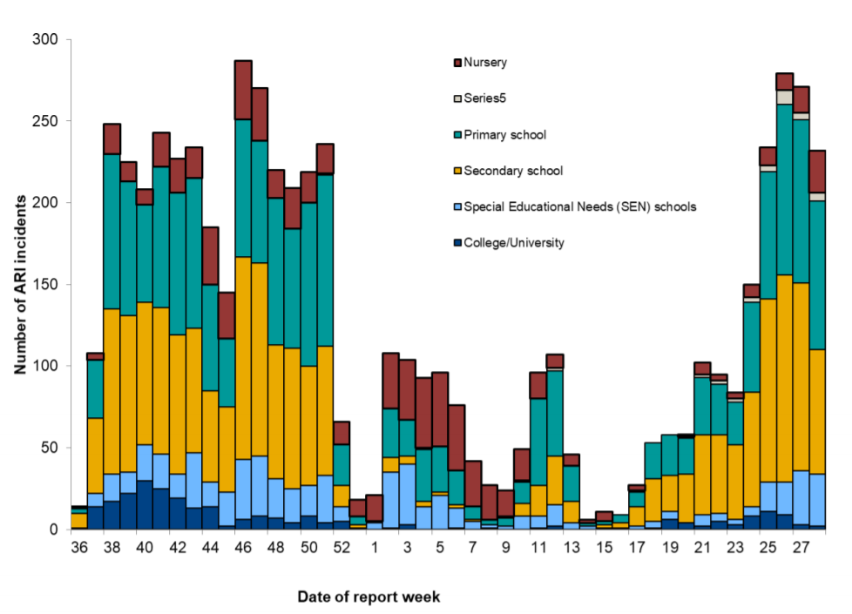
Community surveillance, England
Highlight:
The number of ARI cases reported have steadily increased since schools reopened on 19 April. However, cases have reduced for secondary school, but increased for nursery settings.
Number of ARI incidents or outbreaks by type of educational setting, England
Source: National flu and COVID-19 surveillance graph

Slide 14
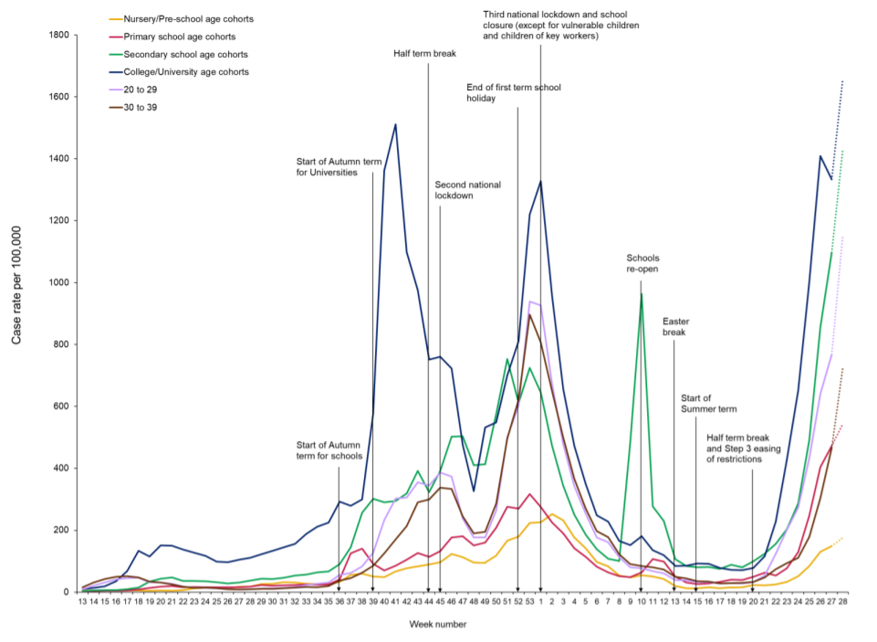
Community surveillance, England
Highlight:
COVID-19 cases are rising in all educational settings.
The reported number of cases for all age cohorts, are to be higher than the number of confirmed cases seen over summer 2020.
Weekly incidence of lab confirmed COVID-19 cases per 100,000 in nursery, primary school, secondary school and college/university cohorts
Source: National flu and COVID-19 surveillance graph

Slide 15
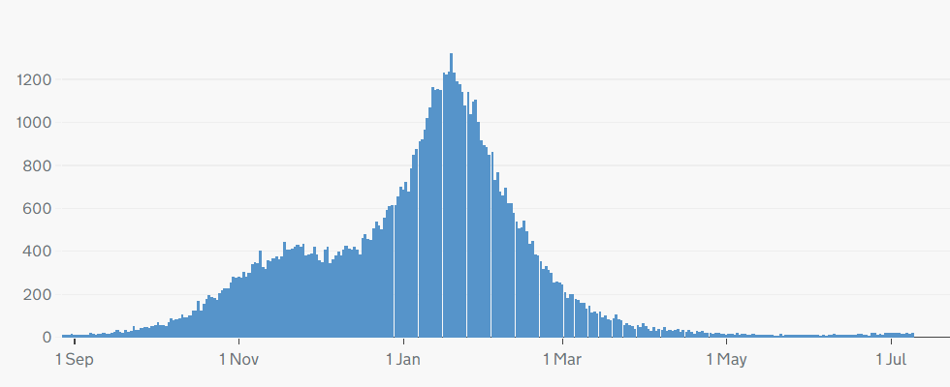
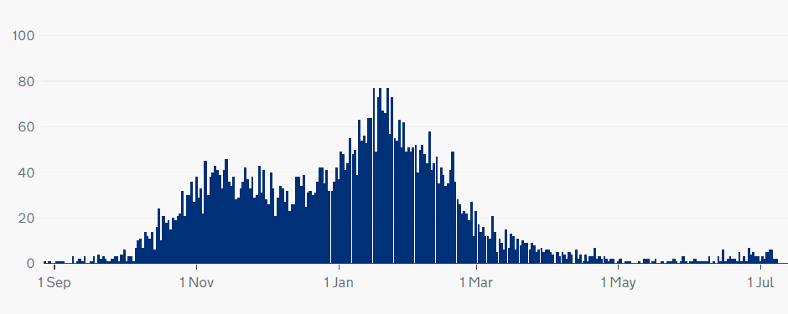
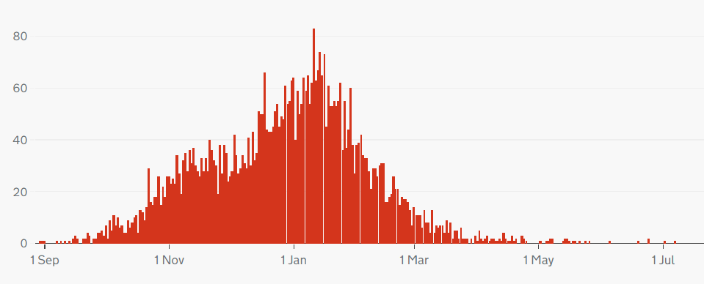
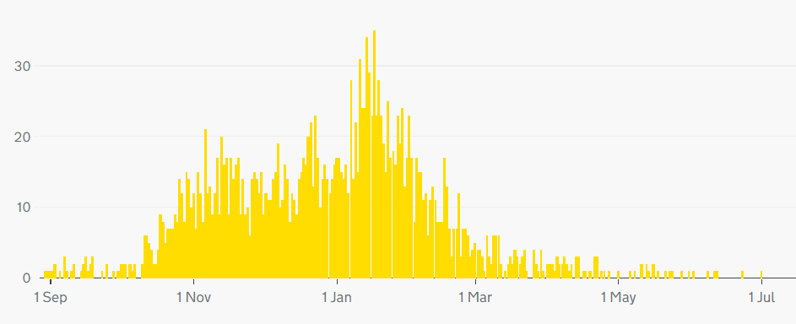
COVID-19 deaths, UK
Highlight:
The number of deaths with COVID-19 listed on the death certificate has levelled out across the UK.
Note: different scales – but overall trend is similar across nations.
Cumulatively, as of 9 July, 153,070 people have died of COVID-19 in the UK.
Daily deaths with COVID-19 on the death certificate
England
Scotland
Wales
Northern Ireland
Source: Gov.uk COVID-19 dashboard

Slide 16
COVID-19 deaths by age, England and Wales
Highlight:
Deaths remain low across all age groups.
Deaths per 100,000 by age group (England and Wales)
Source: ONS, Deaths registered weekly in England and Wales, provisional

Slide 17
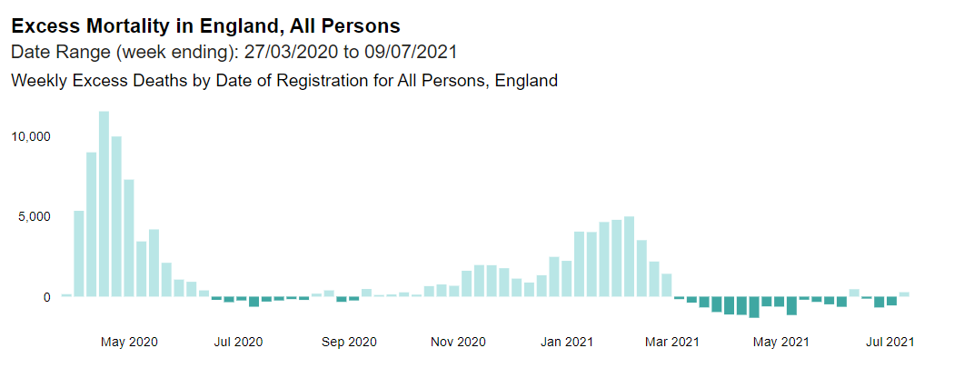
Excess deaths, England
Highlight:
Excess deaths have fallen since April 2021. Latest figures for the week ending 9 July indicate that there have been 91,075 excess deaths since March 2020.
Excess deaths = registered deaths – expected deaths
Source: PHE, Excess mortality in England

Slide 18
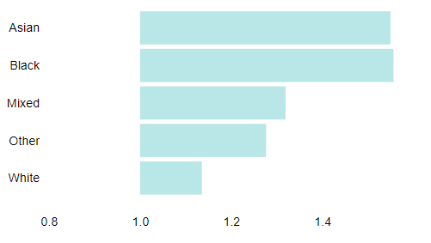
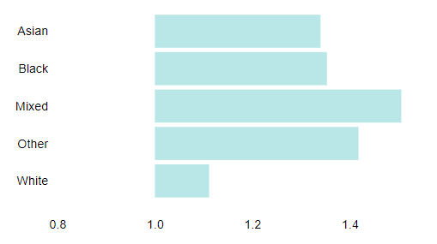
Excess deaths by ethnicity
Highlight:
The ratio of registered deaths to expected deaths is much higher among men and women of Asian and Black ethnicities compared to deaths in White groups.
Ratio of registered deaths to expected deaths for ethnic groups
in England 27 March 2020 – 2 July 2021
Males
Females
Source: PHE, Excess mortality in England

Slide 19
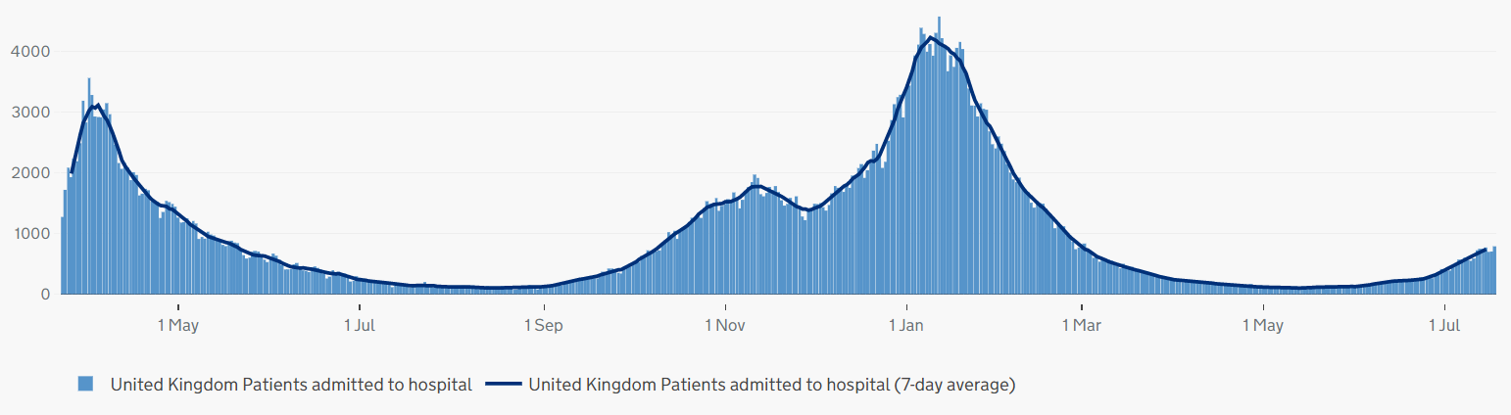
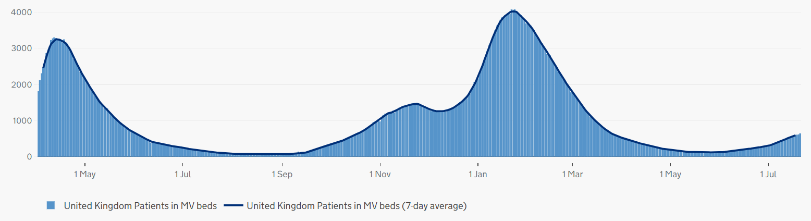
Hospitalisations
Patients in hospital with COVID-19, UK
Highlight:
​Hospitalisations have slightly risen in recent weeks but are well below the peak in mid-January and are reaching similar levels to those seen in mid-September 2020. ​
​
As of 21 July, there were 4,861 people in hospital with COVID-19, with 647 patients in mechanical ventilation beds. The 7-day rolling average is below what it was at the height of the first wave, and below the level seen at the beginning of the second and third waves.
Patients with COVID-19 in mechanical ventilation beds, UK
Source: Gov.uk COVID-19 dashboard

Slide 20
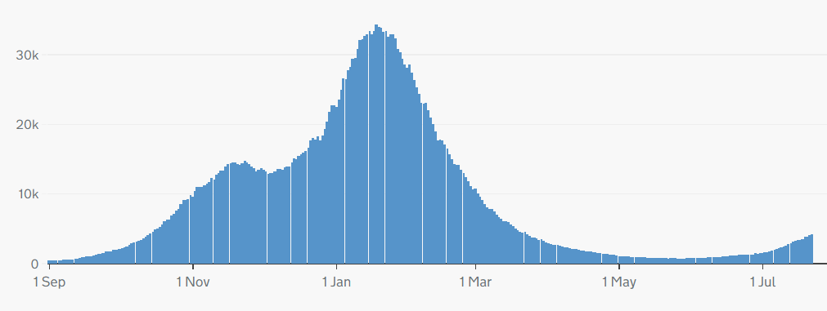
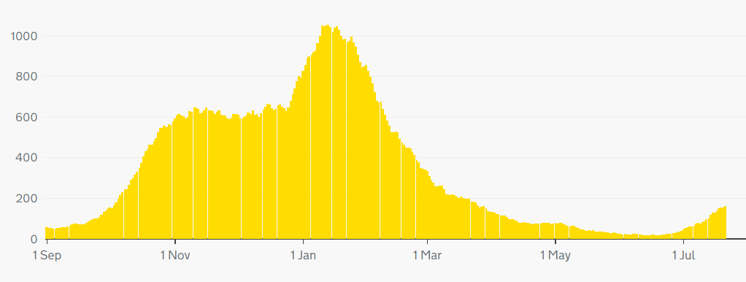
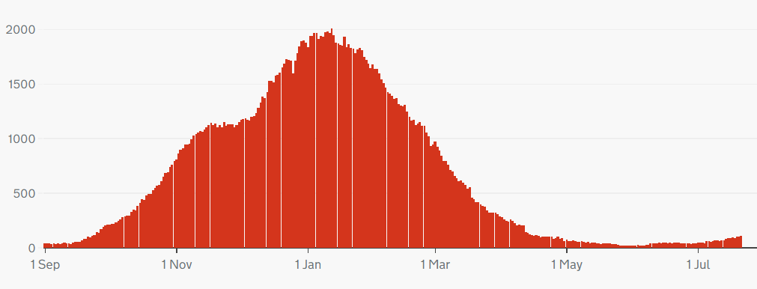
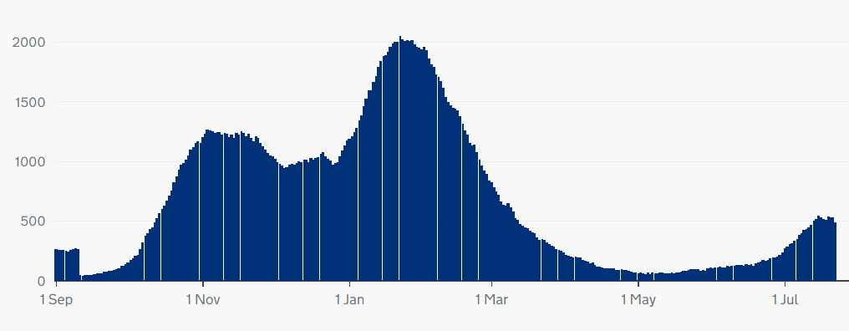
Hospitalisation trends, UK
Note: different scales – but overall trend similar across UK nations.
England
Northern Ireland
Wales
Scotland
Source: Gov.uk COVID-19 dashboard

Slide 21
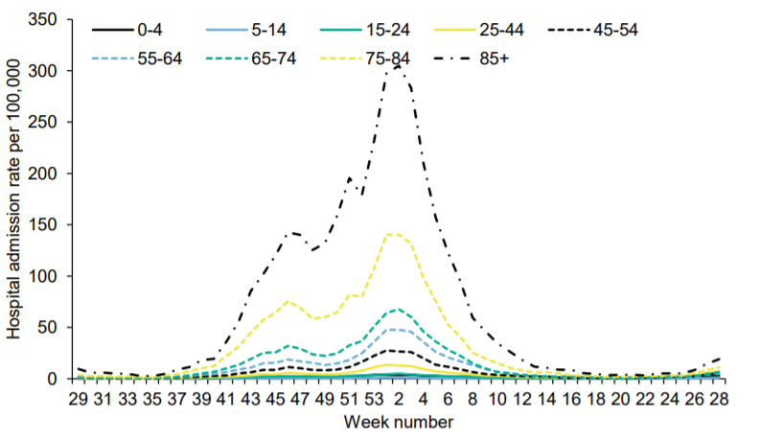
Hospital admissions by age
Highlight:
Hospital admissions for all age groups remain low.
Weekly hospital admissions by age group
Source: National flu and COVID-19 surveillance report

Slide 22
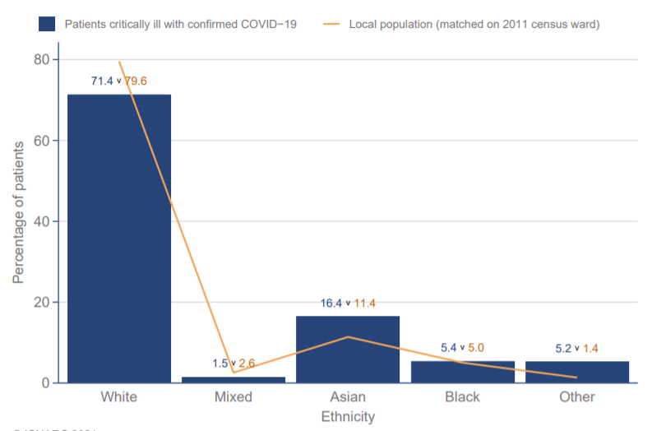
ICNARC data - ethnicity
Highlight:
Data from the Intensive Care National Audit and Research Centre (ICNARC) shows that those from Asian and Black ethnic backgrounds make up a disproportionate percentage of patients critically ill with COVID-19 (compared to the proportion of Asian and Black people in local populations).
Ethnicity distribution compared to local population - patients critically ill with COVID-19 admitted from 1 Sept 2020
Source: ICNARC report on COVID-19 in critical care (UK)

Slide 23
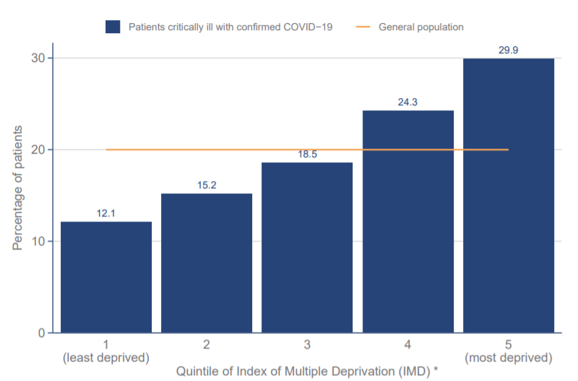
ICNARC data - deprivation
Highlight:
ICNARC data on deprivation shows those from more deprived backgrounds make up a disproportionate percentage of patients critically ill with COVID-19.
Index of Multiple Deprivation – distribution of patients critically ill with COVID-19 admitted since 1 September 2020 compared with general population
Source: ICNARC report on COVID-19 in critical care (UK)

Slide 24
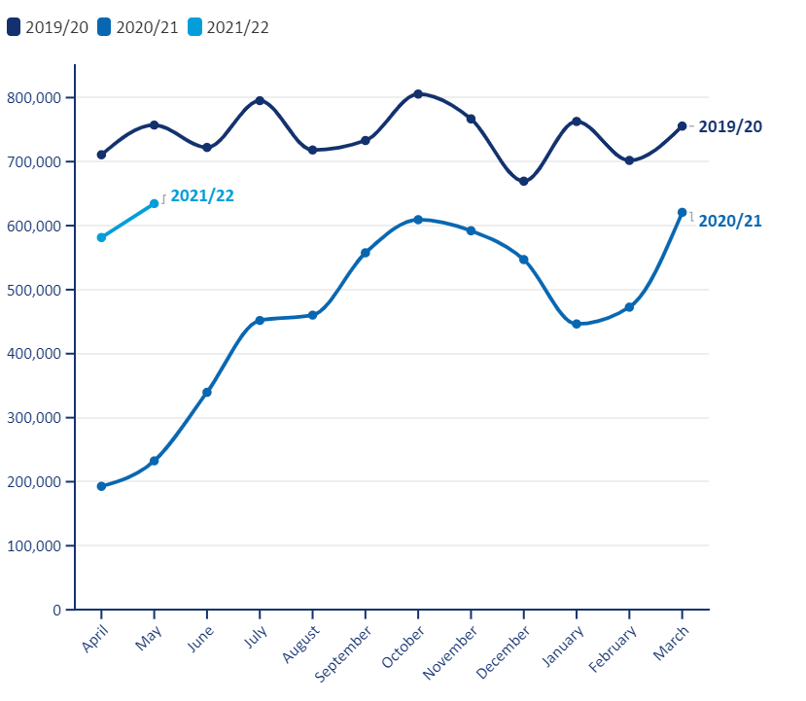
Non-COVID-19 Backlog, England
Elective procedures (all specialties) – 2019/20 versus 2020/21
Highlight:
The latest activity data shows a continued disruptive impact of COVID-19 on NHS elective care.
The BMA estimates that between April 2020 and May 2021 there were:
3.63 million fewer elective procedures
23.67 million fewer outpatient attendances.
Source: BMA analysis of NHS Digital Hospital Episode Statistics for Admitted Patient Care and Outpatient Data

Slide 25
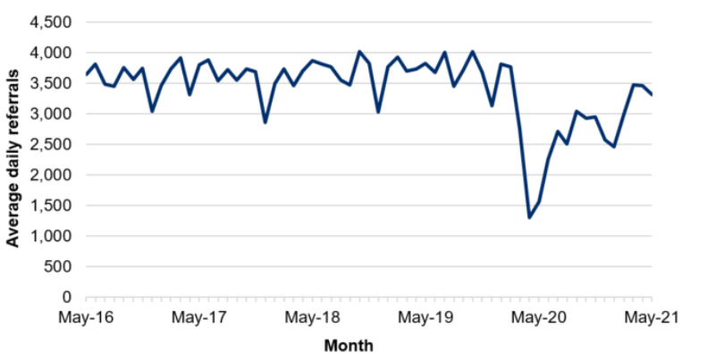
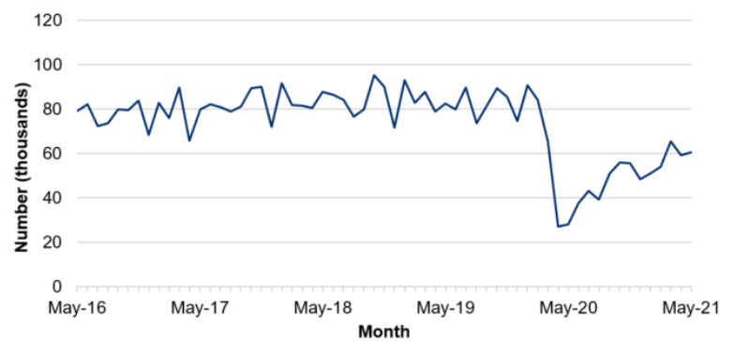
NHS pressures - Wales
Average daily number of referrals for first outpatient appointments
Highlight:
COVID-19 has caused considerable disruption to non-COVID-19 care in Wales.
The number of referrals for out-patient appointments fell sharply in the initial months of the pandemic before recovering to around 75% of expected levels over the summer of 2020. They fell again during January 2021 but are now recovering.
The number of patient pathways open also fell sharply during the initial months of the pandemic before starting to recover.
Next update: 19 August 2021
Number of closed patient pathways
Source: Gov.wales, NHS activity and performance summary

Slide 26
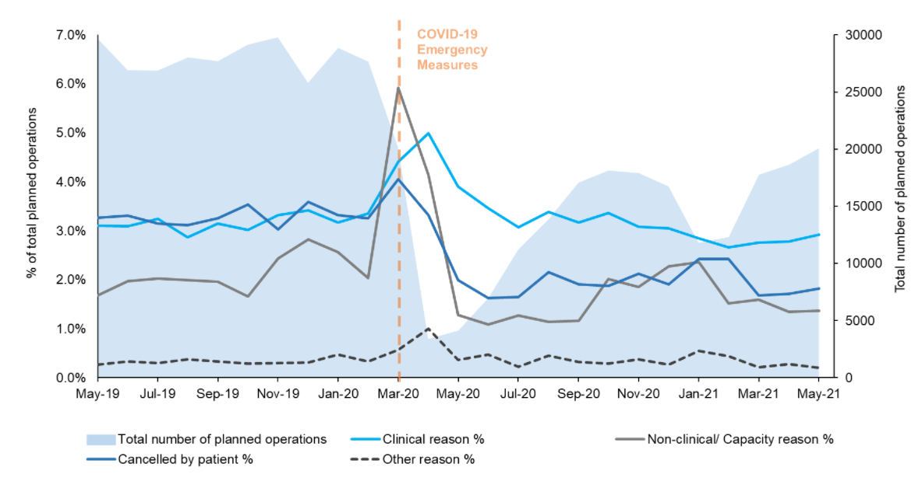
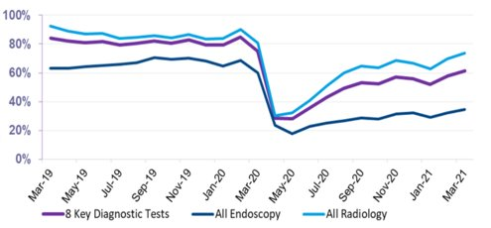
NHS pressures –
Scotland
Total planned operations and percentage of cancelled planned operations
Highlight:
Scheduled elective operations in the NHS in Scotland reduced sharply at the beginning of the pandemic before recovering slightly over the summer, and beginning to fall again towards the end of 2020. The latest data for May 2021 shows that elective care has not yet recovered to pre-pandemic levels.
Since April 2020, there have been 143k fewer elective operations than would normally be expected (based on 2019 trends).
Next update: August 2021
The number of patients waiting 6 weeks or less fell sharply at the beginning of the pandemic, with partial recovery over the rest of 2020. When comparing to pre-pandemic levels, the waiting list size is 19.6% higher than 28 February 2020.​
Next update: August 2021
Source: Public Health Scotland, Cancelled planned operations
Percentage of patients waiting 6 weeks or less at month end, by test type
Source: Public Health Scotland, NHS waiting times - diagnostics

Slide 27
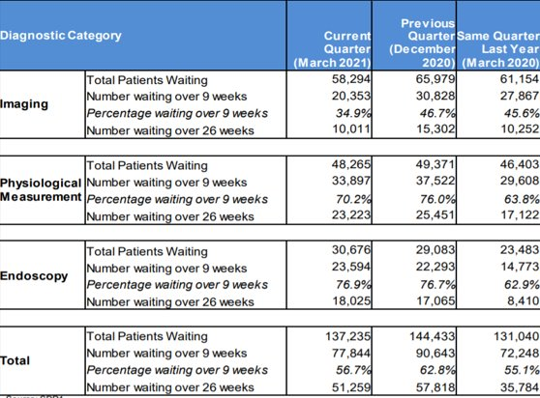
NHS pressures – Northern Ireland
Highlight:
COVID-19 has affected waiting times for diagnostic services in Northern Ireland.
The number of patients waiting over 9 weeks and over 26 weeks both rose in the Quarter up to September 2020, reflecting the disruption to services seen during the initial phases of the pandemic.
Waiting times have recovered somewhat in the Quarter ending March 2021, but remain higher than the same Quarter in 2020.
Source: Northern Ireland waiting time statistics: diagnostic waiting times

