Slide 1
Weekly Covid-19 data update
19/03/2021
Contact: Jon Ware, Head of Health Policy
jware@bma.org.uk

Slide 2
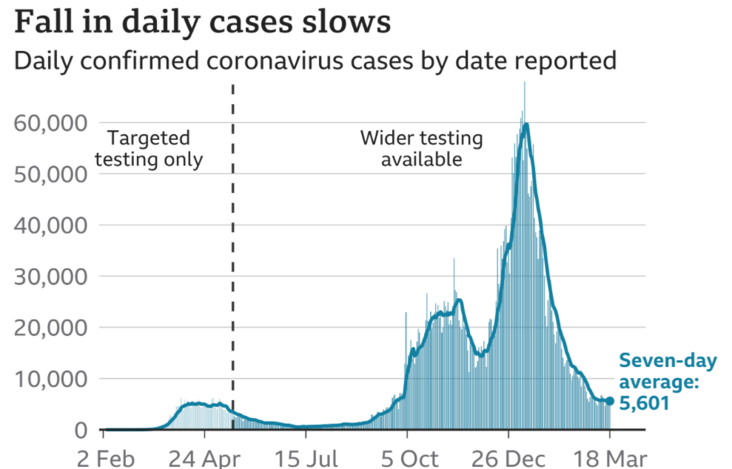
Cases – UK wide
Highlight:
Daily cases appear to fluctuate, with 6,303 confirmed cases across the UK reported on 18 March, compared to 6,753 the week before.
The seven-day average indicates that the number of cases appear to be reaching a plateau, with a reduction in the rate at which they were falling over the last weeks. Cases still appear to be substantially higher than in the summer.
Source: Gov.uk COVID-19 dashboard (graph via BBC)

Slide 3
Cases by nation (and English regions)
Highlight:
Cases have been falling across England, Scotland, Wales and Northern Ireland, but the rate of decrease has reduced and appears to be beginning to level out. Cases are still falling across English regions, although with considerable variation in cases per 100k between different areas. Meanwhile, in Yorkshire and The Humber, cases have risen over the last week.
Cases per 100,000 by nation, last 7 days
Cases per 100,000 by English region, last 7 days
English Region | Cases per 100k | % Change compared to last week
Yorkshire and The Humber | 107.6 | + 7.6 %
East Midlands | 78.9 | -9.1 %
North East | 78.2 | -1.4 %
North West | 74.7 | -0.3 %
West Midlands | 66.6 | -9.4%
East of England | 44.3 | -8.9%
London | 39.1 | -5.3 %
South East | 36.4 | -2.4 %
South West | 31 | -6.3 %
Source: Gov.uk COVID-19 dashboard (BMA graph)

Slide 4
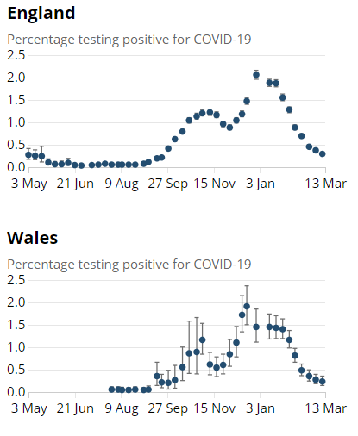
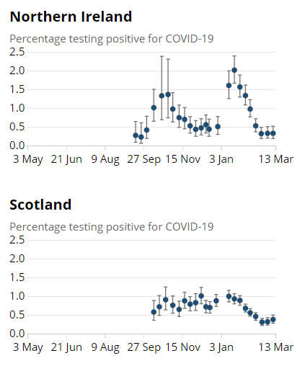
ONS infection survey data (13/03/21)
Highlight:
Latest ONS infection survey data runs up to 13 March and continues to show a fall in cases in England and Wales with a plateau in Northern Ireland. Cases have increased in Scotland.
Nation | Estimated pop with Covid | Previous week
England | 160,200 | 200,600
Wales | 7,000 | 8,300
Scotland | 19,300 | 16,600
N Ireland | 5,800 | 5,900
Source: ONS COVID-19 Infection Survey

Slide 5
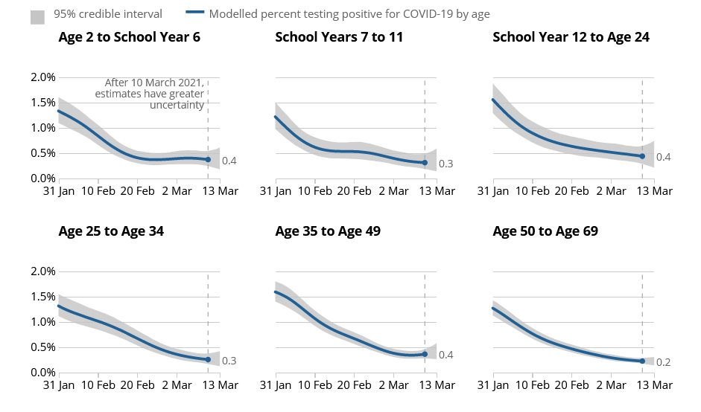
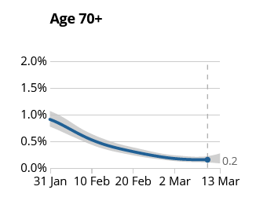
Infections by age group
Highlight:
Infection rates across age groups have been falling, but the rate of decrease has slowed down
Estimated % of population testing positive for COVID by age group
Source: ONS COVID-19 Infection Survey

Slide 6
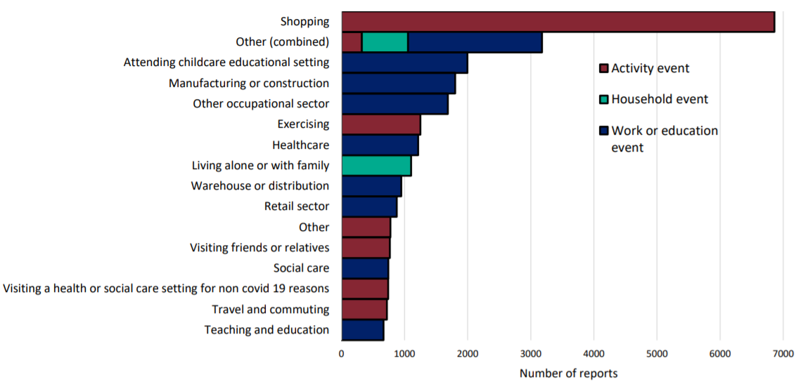
Community surveillance, England
Events and activities reported by people testing positive, prior to symptom onset, week 10
Highlight:
Shopping and work related activities continue to be reported as recent events/activities by those testing positive for COVID-19 (although this doesn’t give us a clear indication of exactly where transmission is likely to be taking place)
Source: National flu and COVID-19 surveillance graph

Slide 7
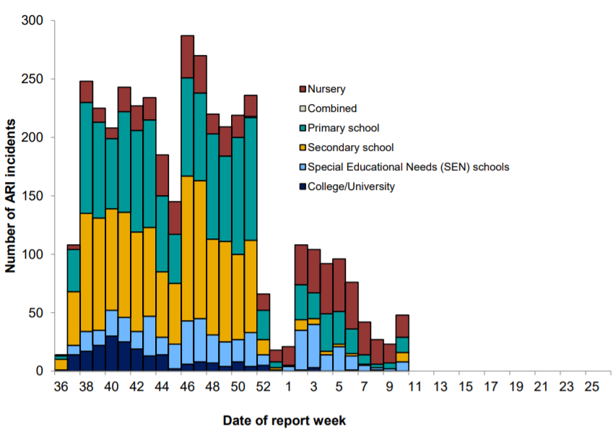
Community surveillance, England
Highlight:
This week there has been an overall increase in outbreaks across all educational settings, notably in primary, secondary and SEN schools.
Number of ARI incidents or outbreaks by type of educational setting, England.
Source: National flu and COVID-19 surveillance graph

Slide 8
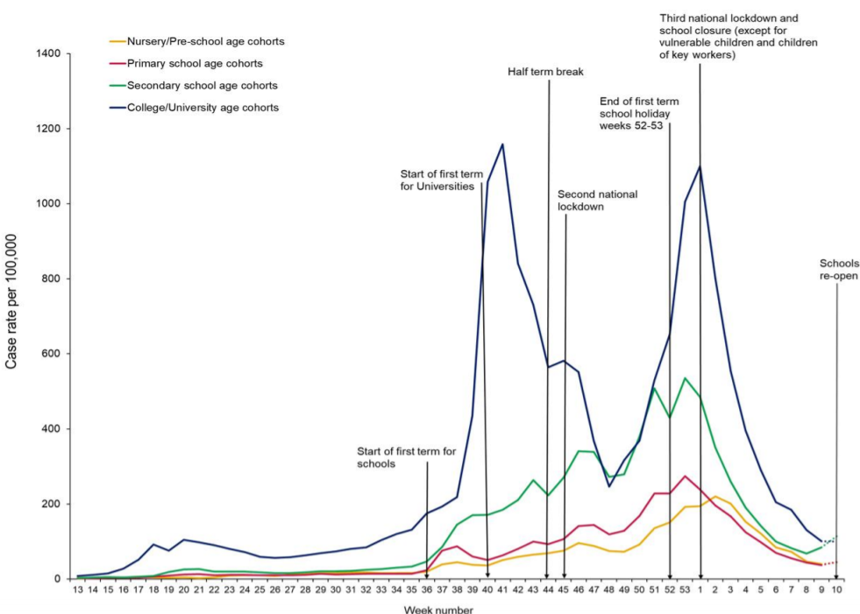
Community surveillance, England
Weekly incidence of lab confirmed Covid-19 cases per 100,000 in nursery, primary school, secondary school and college/university cohorts
Highlight:
Cases continue to fall across people in nursery, primary school, and college/ university cohorts in week 10 of 2021. However, there has been a slight rise in cases reported for secondary schools.
While there are a low number of cases reported overall, they remain higher than the number of confirmed cases seen over the summer.
Source: National flu and COVID-19 surveillance graph

Slide 9
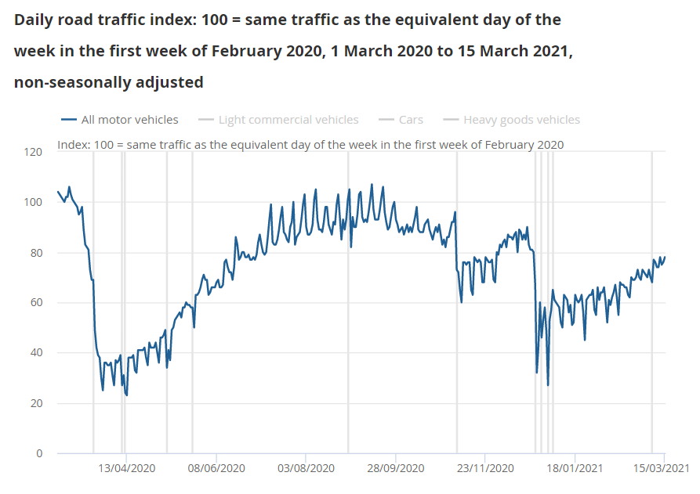
Daily road traffic
Highlight:
Road traffic remains lower than would be expected at this time of year (around 78%). There is more road activity than in the first wave but less than the second wave. Activity continues to grow in recent weeks
Source: ONS, Coronavirus and the latest indicators for the UK economy and society

Slide 10
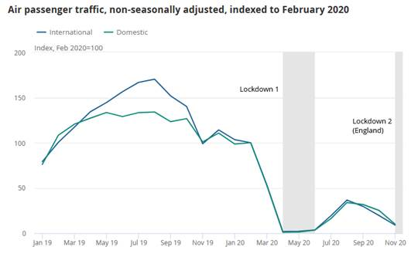
Air traffic
Highlight:
Air traffic at UK airports dropped sharply at the beginning of the pandemic before recovering slightly over the summer of 2020. They have been falling again since August/September and remain at a relatively low level compared to the Feb 2020 baseline.
Source: ONS, Coronavirus and the impact on the UK travel and tourism industry

Slide 11
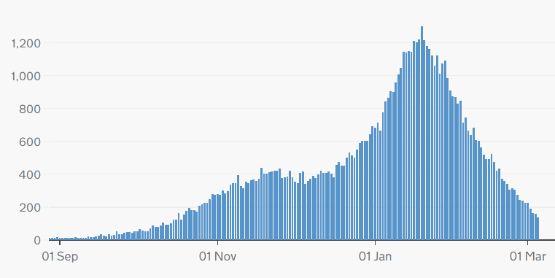
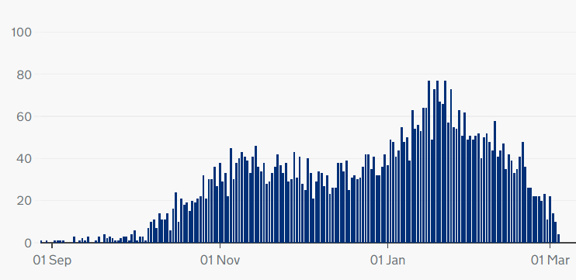
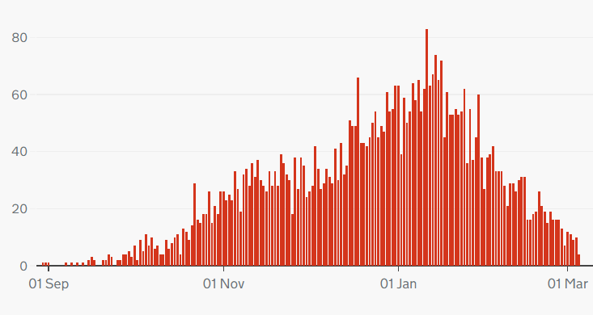
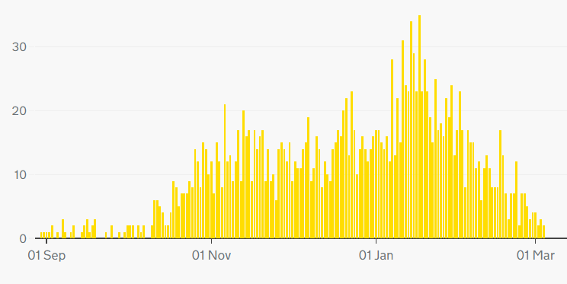
COVID-19 deaths, UK
Highlight:
Deaths continue to fall across the UK.
Cumulatively as of 5 Mar 146,487 people have died of COVID-19 in the UK.
Daily deaths with COVID-19 on the death certificate by date of death
England
Scotland
Wales
Northern Ireland
Source: Gov.uk COVID-19 dashboard

Slide 12
COVID deaths – age breakdown (England and Wales)
Weekly deaths from COVID-19 by age group
Highlight:
Deaths continue to fall across all age groups
Source: ONS, Deaths registered weekly in England and Wales, provisional

Slide 13
Excess deaths, England
Highlight:
Excess deaths have been falling over March. There have been 101,825 excess deaths since March 2020.
Source: PHE, Excess mortality in England
Notes:
I’ve used the two weekly death charts that are shown when you open the document. The highlight would need to be changed to reflect this.
Figures in the new data sets indicate that since March there have been 101,345 excess deaths while previous highlight said 101,825 excess deaths – might indicate a more accurate methodology. The excess deaths do not seem to appear. https://app.powerbi.com/view?r=eyJrIjoiYmUwNmFhMjYtNGZhYS00NDk2LWFlMTAtOTg0OGNhNmFiNGM0IiwidCI6ImVlNGUxNDk5LTRhMzUtNGIyZS1hZDQ3LTVmM2NmOWRlODY2NiIsImMiOjh9

Slide 14
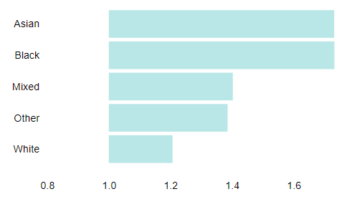
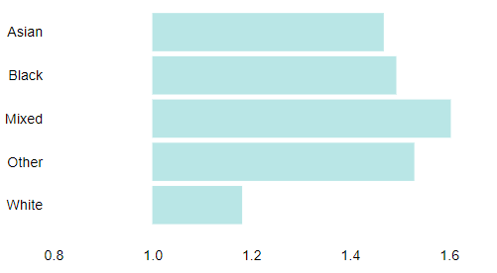
Excess deaths by ethnicity
Highlight:
The ratio of registered deaths to expected deaths is much higher amongst people of Asian, Black and Mixed ethnicity.
Ratio of registered deaths to expected deaths for ethnic groups
in England 27 Mar 2020 - 6 Mar 2021:
Males
Females
Source: PHE, Excess mortality in England

Slide 15
Critical care bed capacity (England)
Adult critical care bed numbers and occupation levels, winter 2020 and 2021 comparison
Highlight:
The number of critical care beds open in England has been steadily falling since January, but continues to be higher than the equivalent months last year.
Source: Urgent and Emergency Care Daily Situation Reports 2020-21

Slide 16
Hospitalisations
Patients in hospital with COVID-19, UK
Highlight:
Hospitalisations have continued to fall since the recent peak in mid-January but remain higher than the summer.
As of 15 March there were 7,218 people in hospitals with COVID-19. The 7-day rolling average is now below what it was at the height of the first wave, and below the level seen at the beginning of the second and third waves.
Patients with COVID-19 in mechanical ventilation beds, UK
Source: Gov.uk COVID-19 dashboard

Slide 17
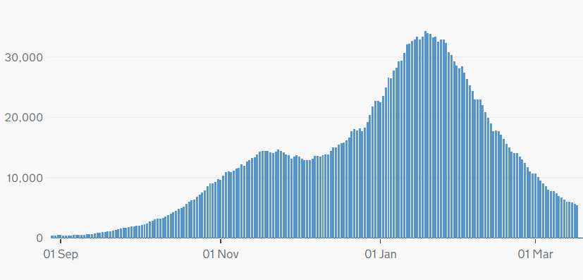
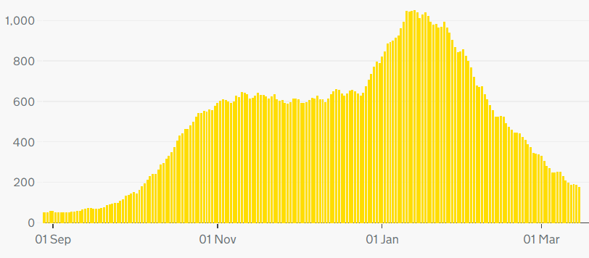
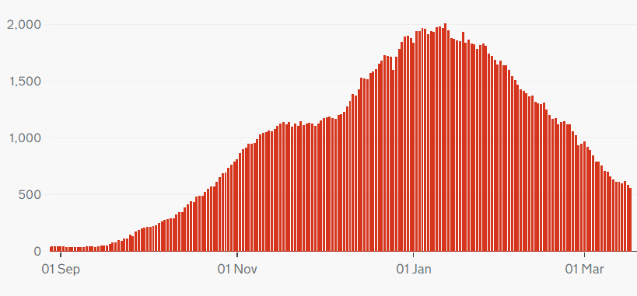
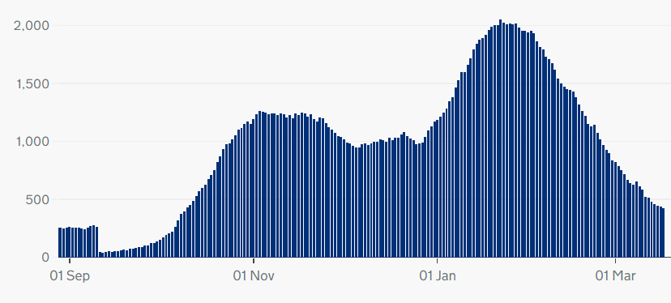
Hospitalisation trends across the UK
Highlight:
Note different scales – but overall trend similar across UK nations
England
Northern Ireland
Wales
Scotland
Source: Gov.uk COVID-19 dashboard

Slide 18
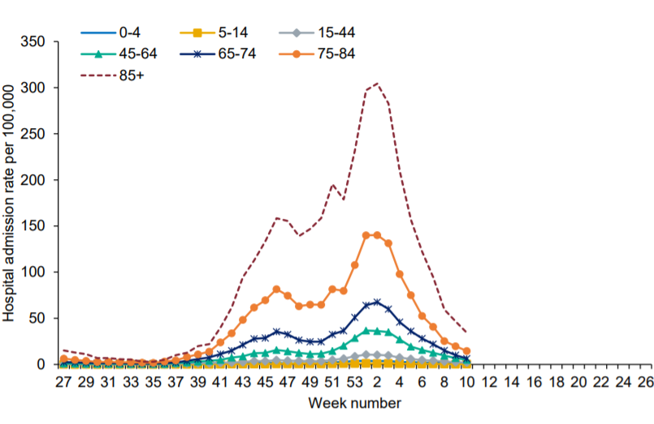
Hospital admissions by age
Weekly hospital admission rates per 100,000 by age group
Highlight:
Hospital admissions for all age groups continue to fall, with a significant drop seen in those aged 85+.
Source: National flu and COVID-19 surveillance report

Slide 19
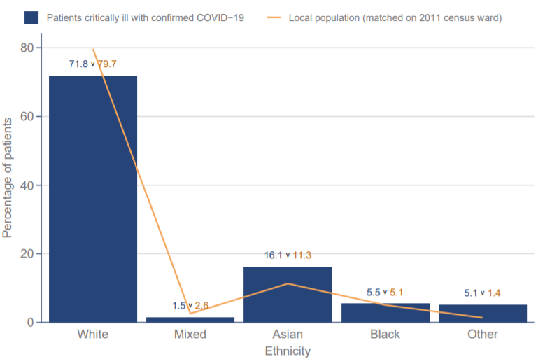
ICNARC data - ethnicity
Ethnicity distribution compared to local population - patients critically ill with COVID-19 admitted from 1 Sept 2020
Highlight:
Data from the Intensive Care National Audit and Research Centre (ICNARC) shows that those from Asian and Black ethnic backgrounds make up a disproportionate percentage of patients critically ill with COVID-19 (compared to the proportion of Asian and Black people in local populations)
Source: ICNARC report on COVID-19 in critical care (UK)

Slide 20
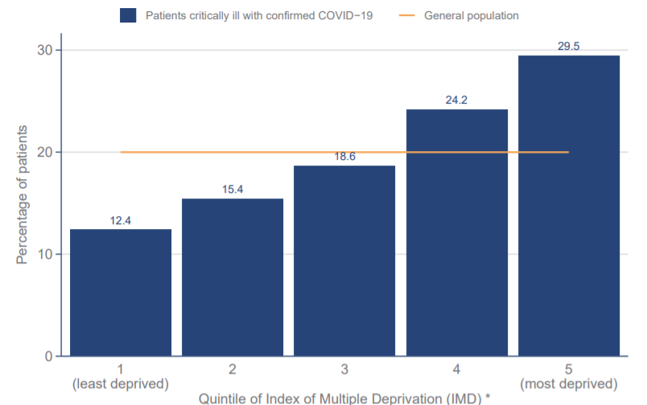
ICNARC data -deprivation
Index of Multiple Deprivation – distribution of patients critically ill with COVID-19 admitted since 1 September compared with general population
Highlight:
ICNARC data on deprivation shows those from more deprived backgrounds make up a disproportionate percentage of patients critically ill with COVID-19
Source: ICNARC report on COVID-19 in critical care (UK)

Slide 21
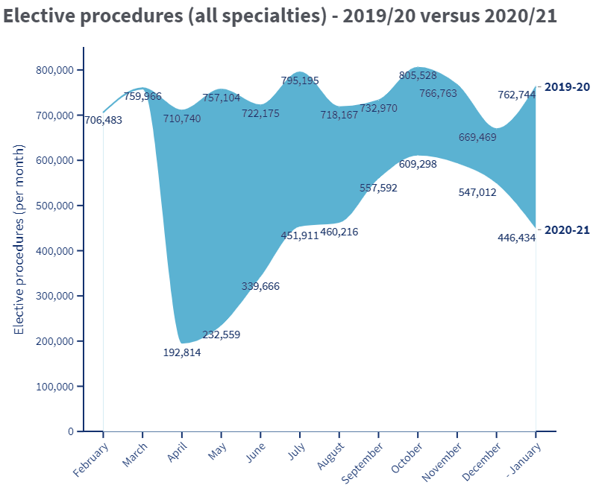
Non-COVID Backlog, England
Highlight:
The data for January shows a significant drop in elective activity in England as hospitals focused on COVID-19
The BMA estimates that between April 2020 and January 2021 there were:
3 million fewer elective procedures
20.73 million fewer outpatient attendances
Next update: 15 April
Source: BMA analysis of NHS Digital Hospital Episode Statistics for Admitted Patient Care and Outpatient Data

Slide 22
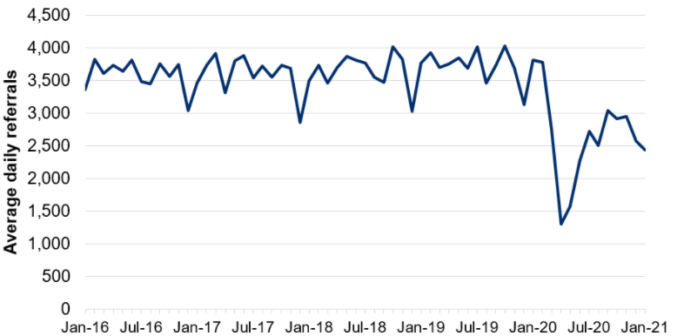
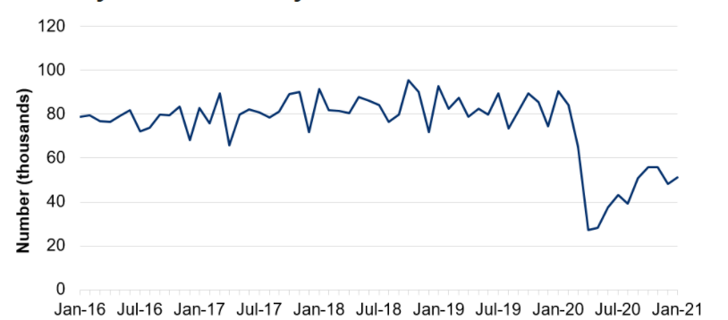
NHS pressures: Wales
Average daily number of referrals for first outpatient appointments
Highlight:
COVID-19 has caused considerable disruption to non-COVID care in Wales.
The number of referrals for first out-patients appointments fell sharply in the initial months of the pandemic before recovering to around 75% of expected levels over the summer of 2020. They fell again during January 2021.
The number of patient pathways open also fell sharply during the initial months of the pandemic before starting to recover.
Next update: 22 April 2021
Number of closed patient pathways
Source: Gov.wales, NHS activity and performance summary

Slide 23
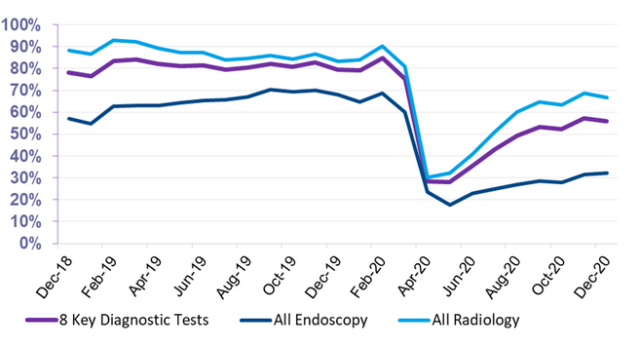
NHS pressures – Scotland
Total Number of scheduled elective operations in theatre system
Highlight:
Scheduled elective operations in the NHS in Scotland reduced sharply at the beginning of the pandemic before recovering slightly over the summer, and beginning to fall again towards the end of 2020. The latest data for Jan 2021 shows a further dip as NHS Scotland dealt with high numbers of COVID-19 patients.
Since March 2020, there have been 143k fewer elective operations than would normally be expected (based on 2019 trends)
The number of patients waiting 6 weeks or less fell sharply at the beginning of the pandemic, with partial recovery over the rest of 2020
Source: Public Health Scotland, Cancelled planned operations
Percentage of patients waiting 6 weeks or less at month end, split by test type
Source: Public Health Scotland, NHS waiting times - diagnostics

Slide 24
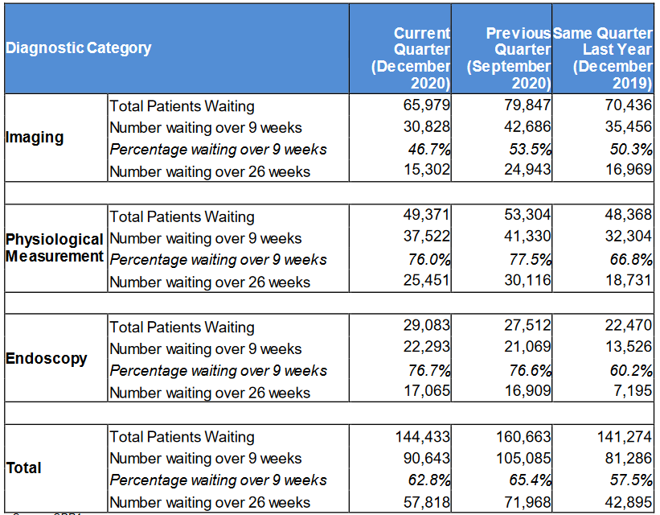
NHS pressures – Northern Ireland
Highlight:
COVID-19 has affected waiting times for diagnostic services in Northern Ireland
The number of patients waiting over 9 weeks and over 26 weeks both rose in the Quarter up to September 2020, reflecting the disruption to services seen during the initial phases of the pandemic
Waiting times have recovered somewhat in the Quarter ending December 2020, but remain higher than the same Quarter in 2019
Source: Northern Ireland waiting time statistics: diagnostic waiting times

Slide 25
Cumulative vaccination coverage by nation
Highlight:
Approximately two fifths of the population in the UK have received their first dose of vaccination.
Source: Gov.uk, Vaccinations in United Kingdom

Slide 26
Vaccination coverage, UK
Highlight:
Note: The weekly tables run up to 14 March.
The number of people receiving their first vaccination continues to fall, while the number of people receiving their second dose continues to grow, corresponding to people that are coming up towards the 12 weeks of having received their first dose.
Source: Gov.uk, Vaccinations in United Kingdom (BMA graph)

Slide 27
Vaccination coverage by age group, England
Highlight:
Latest NHSE data covers vaccinations up to 14 March.
Coverage is high, with an increase in the number of under 60s receiving their first dose, and an increase in the number of over 80’s receiving their second.
*101.5% - percentages are based on 2019 ONS population estimates which are not perfect
(+0.4)
(+0.2)
(+0.3)
(+2)
(+14.3)
(+4.6)
(+0.5)
(+0.3)
(+0.3)
(+0.6)

Slide 28
Vaccine uptake among estimated number of NHS frontline staff, England
Region | As of 21 February | As of 28 February | As of 7 March | As of 14 March
North East And Yorkshire | 97% | 98.50% | 100% | 100%*
South West | 96% | 98.10% | 99.60% | 100%*
East Of England | 94% | 96.20% | 97.60% | 98.95%
South East | 94% | 96% | 97.50% | 99.16%
North West | 94% | 96% | 97.60% | 99.47%
Midlands | 91% | 93.30% | 95.10% | 96.64%
London | 76% | 78.70% | 80.80% | 82.88%
Highlight:
Latest NHSE vaccination data indicates that all regions, with the exception of London, have vaccinated over 95% of frontline workers.
Uptake is increasing slowly by an overall 1- 2 percentage points across the regions. The uptake in London steadily increases by 2 percentage points week by week.

